Slide 1
Power Of Compassion
Text: Romans 12:19-21
(Matthew 5:43-45)
Notes:
Prepared by Nathan L Morrison
All Scripture given is from NASB unless otherwise stated
For further study, or if questions, please Call: 804-277-1983 or Visit: www.courthousechurchofchrist.com

Slide 2
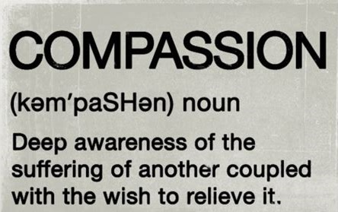
Intro
(American Heritage Dictionary)
“A suffering with another; painful sympathy; a sensation of sorrow excited by the distress or misfortunes of another; pity; commiseration. Compassion is a mixed passion, compounded of love and sorrow; at least some portion of love generally attends the pain or regret, or is excited by it. Extreme distress of an enemy even changes enmity into at least temporary affection.”
(Webster’s College Dictionary)

Slide 3
Intro
Shirley Plantation (Hopewell, VA) during the Civil War (1862)
The men all left to fight for the South
The women were left to tend the farm
July 2, 1862 in the morning the women found their lawn full of wounded and dying Union troops!
Notes:
Shirley Plantation (Hopewell, VA)

Slide 4
Intro
Shirley Plantation (Hopewell, VA) during the Civil War (1862)
The women had compassion on the men and turned their residence into a field hospital for the Union soldiers!
“Their acts of compassion spared Shirley from attack”
Gen. McClellan said they had saved
many lives!
They were issued a Federal Order of Safeguard and soldiers were stationed as guards at their gate!
Notes:
Shirley Plantation (Hopewell, VA)

Slide 5
Intro
Mt. 5:43-44 (Jesus taught…)
43. "You have heard that it was said, 'YOU SHALL LOVE YOUR NEIGHBOR and hate your enemy.'
44. "But I say to you, love your enemies and pray for those who persecute you,
45. so that you may be sons of your Father who is in heaven; for He causes His sun to rise on the evil and the good, and sends rain on the righteous and the unrighteous.
Notes:
Shirley Plantation (Hopewell, VA)

Slide 6
Intro
Romans 12:19-21
19. Never take your own revenge, beloved, but leave room for the wrath of God, for it is written, "VENGEANCE IS MINE, I WILL REPAY," says the Lord.
20. "BUT IF YOUR ENEMY IS HUNGRY, FEED HIM, AND IF HE IS THIRSTY, GIVE HIM A DRINK; FOR IN SO DOING YOU WILL HEAP BURNING COALS ON HIS HEAD."
21. Do not be overcome by evil, but overcome evil with good.
There is power in compassion, both in this life and in the one to come!
Notes:
Shirley Plantation (Hopewell, VA)

Slide 7
Jesus, Our Example in Compassion
I Pet. 2:21-25: Jesus left for us an example to follow so that we may not go astray
Jesus was moved by compassion on many occasions…
Prior to feeding the five thousand (Mt. 14:14)
Prior to feeding the four thousand (Mt. 15:32)
Compassion towards a leper (Mark 1:41) – Healed him!
Compassion for the widow of Nain (Luke 7:13) – Raised her only son from the dead!
Compassion shown to two blind men (Mt. 20:34) – Healed them!
Compassion caused Him to teach (Mk. 6:34) – Saw they were like sheep without a shepherd so He taught them “many things.” His word brings us back to God! (I Pet. 2:25)
His compassion caused Him to die for His enemies and take away the sins of the world (Jn. 1:29; 3:16; Rom. 5:6-10) – He grants eternal life to those who obey Him!
He is now our compassionate High Priest (Heb. 2:17-18; 4:14-16) – He is merciful and sympathetic to our troubles in life!

Slide 8
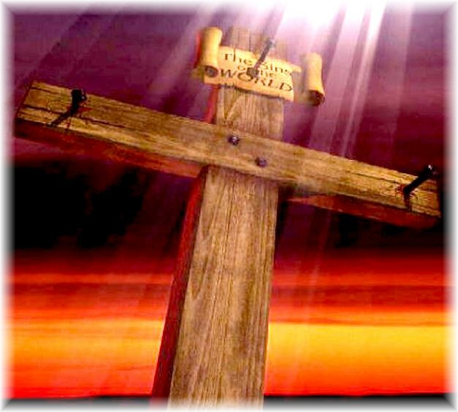
Jesus, Our Example in Compassion
Jesus’ compassion moved Him to do what was best for people!

Slide 9
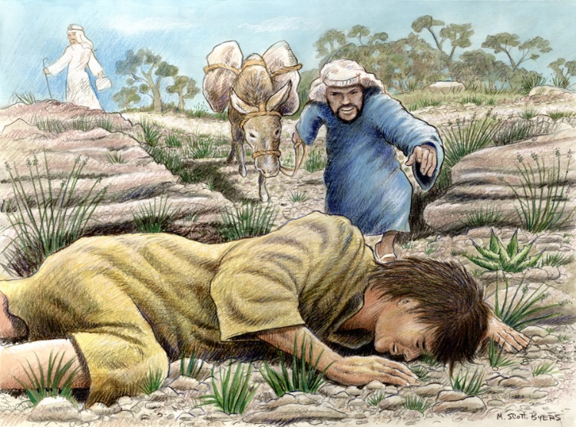
The Good Samaritan Showed Compassion
Lk. 10:25-37: Jesus taught from the parable of “The Good Samaritan” to “Go, and be a neighbor!”
The Samaritan’s compassion…
Lk 10:33: “A Samaritan came by…and he had compassion on him.”
That was what made the difference in the actions of all involved in this story told by Jesus:
The robbers did not have compassion, the priest and Levite did not have compassion, but the Samaritan did! To the Jews, their enemy! (Jn. 4:9)
Jews & Samaritans: hundreds of years of hatred and animosity (Jn. 4:9).
Yet the Samaritan “had compassion.”
Mt. 9:11-13: “I DESIRE COMPASSION, AND NOT SACRIFICE” (Quoted from Hosea 6:6)

Slide 10
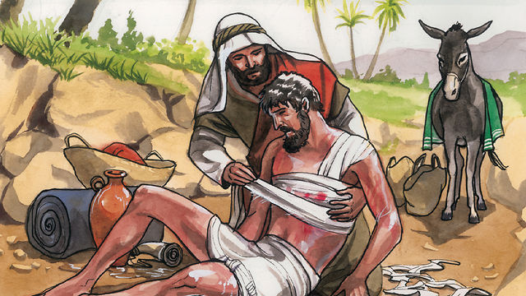
The Good Samaritan Showed Compassion
In compassion, the Samaritan did what needed to be done
His help was impartial (He did not check his color – did not care that the man was a Jew)
His help was spontaneous (He did not consult with others or form a committee)
His help was personal (He got his hands dirty and blood on his clothes)
His help was thorough (He did not decide, “I have done my share, somebody else can take him to the inn”)
He saw it through at great personal expense!

Slide 11
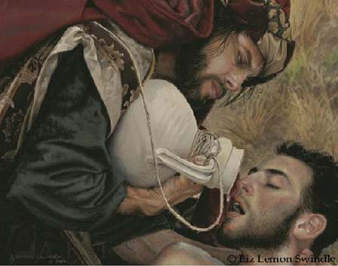
The Good Samaritan Showed Compassion
The Samaritan’s compassion was sacrificial! (It cost him time, effort, oil, wine and money)

Slide 12
Saints are to Show Compassion
Jesus said to love one another as He loved us (Jn. 13:34-35) and forgive as He forgave us (Eph. 4:32; Col. 3:13) – He was the example in all that He said and did!
John 13:34-35
34. "A new commandment I give to you, that you love one another, even as I have loved you, that you also love one another.
35. "By this all men will know that you are My disciples, if you have love for one another."
Eph. 4:32
32. Be kind to one another, tender-hearted, forgiving each other, just as God in Christ also has forgiven you.

Slide 13
Saints are to Show Compassion
Christians are commanded to be compassionate (merciful), loving individuals!
Col. 3:12-14
12. So, as those who have been chosen of God, holy and beloved, put on a heart of compassion, kindness, humility, gentleness and patience;
13. bearing with one another, and forgiving each other, whoever has a complaint against anyone; just as the Lord forgave you, so also should you.
14. Beyond all these things put on love, which is the perfect bond of unity.

Slide 14
Saints are to Show Compassion
We are to have compassion for one another – I Pet. 3:8; 4:8
I Pet. 3:8
8. To sum up, all of you be harmonious, sympathetic, brotherly, kindhearted, and humble in spirit;
I Pet. 4:8
8. Above all, keep fervent in your love for one another, because love covers a multitude of sins.

Slide 15
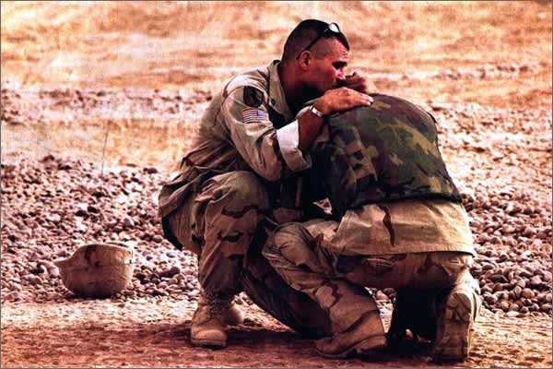
Saints are to Show Compassion
We are to have compassion for one another – I Pet. 3:8; 4:8
Does your compassion go as far as it will serve you? (Phil. 2:3-4)
Does your compassion go as far as doing what is best for others?
Do you have compassion towards your brethren when they sin?
Does your compassion move you to warn them? (Acts 20:31)
How do you treat those who fall away and then come back to God?
Do we allow them to be swallowed up with sorrow? (II Cor. 2:1-8; Prov. 10:12; I Pet. 4:8)

Slide 16
Saints are to Show Compassion
We are to have compassion for one another – I Pet. 3:8; 4:8
We are to have compassion for the lost – Jude 22-23
Jude 22-23 (NKJ)
22. And on some have compassion, making a distinction;
23. but others save with fear, pulling them out of the fire, hating even the garment defiled by the flesh.

Slide 17
Saints are to Show Compassion
We are to have compassion for the lost – Jude 22-23
There are those who “walk” as “enemies of the cross of Christ” (Phil. 3:18).
We are to teach them (as Jesus taught the crowds in Mk. 6:34) so that they may repent and be saved from the fire! (II Tim. 2:24-26; Jude 22-23)

Slide 18
Saints are to Show Compassion
We are to have compassion for one another – I Pet. 3:8; 4:8
We are to have compassion for the lost – Jude 22-23
We are to have compassion for our enemies – Mt. 5:43-45; Rom. 12:19-21
Romans 12:19-21
19. Never take your own revenge, beloved, but leave room for the wrath of God, for it is written, "VENGEANCE IS MINE, I WILL REPAY," says the Lord.
20. "BUT IF YOUR ENEMY IS HUNGRY, FEED HIM, AND IF HE IS THIRSTY, GIVE HIM A DRINK; FOR IN SO DOING YOU WILL HEAP BURNING COALS ON HIS HEAD."
21. Do not be overcome by evil, but overcome evil with good.

Slide 19
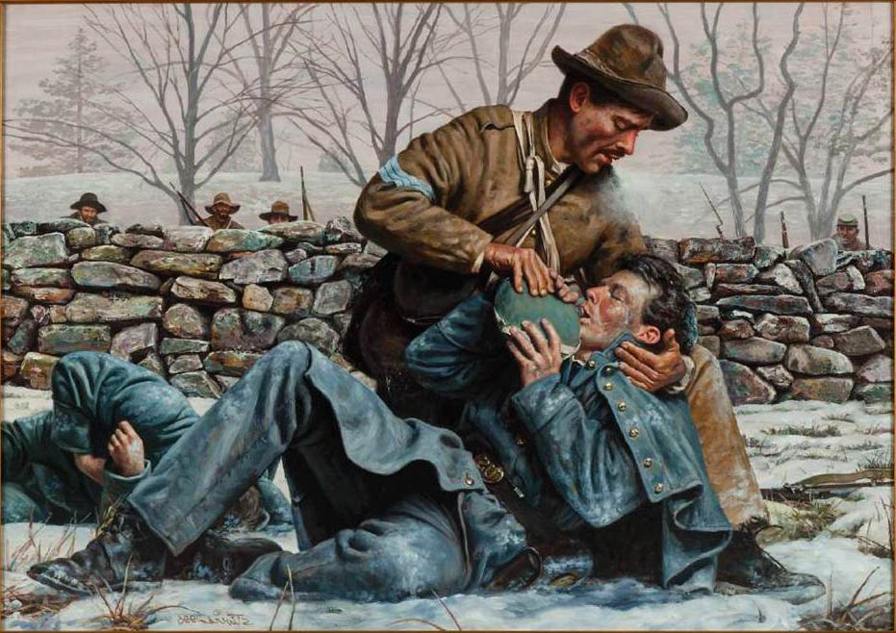
Saints are to Show Compassion
We are to have compassion for our enemies – Mt. 5:43-45; Rom. 12:19-21
We are to pray for those who hate us and persecute us! Hard thing to do!
To offer them the physical help as we are able (Rom. 12:19-21; Gal. 6:10)
To offer spiritual help when needed: to seek to correct and forgive, not to humiliate and condemn (Col. 3:12-14; II Tim. 2:24-26; Jude 22-23)

Slide 20
Saints are to Show Compassion
How we treat others in this life is how we will be treated in the life to come!
Mt. 5:7: The merciful will receive mercy!
Mt. 18:23-35: The Parable of the King and the Unmerciful Servant
We need to be merciful with cheerfulness (Rom. 12:8)!
Paul said he was shown mercy by God so that he would be an example of the grace and loving-kindness of Jesus (I Tim. 1:13-16: He said he was a “violent aggressor”) – like the servant in the parable should have been!
Mercy, compassion and forgiveness are all tied together in our actions – Col. 3:12-14

Slide 21
Saints are to Show Compassion
There is power in compassion!

Slide 22
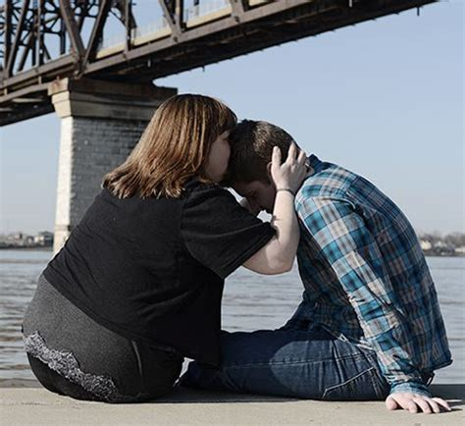
Conclusion
Matthew 9:11-13
11. When the Pharisees saw this, they said to His disciples, "Why is your Teacher eating with the tax collectors and sinners?"
12. But when Jesus heard this, He said, "It is not those who are healthy who need a physician, but those who are sick.
13. "But go and learn what this means: 'I DESIRE COMPASSION, AND NOT SACRIFICE,' for I did not come to call the righteous, but sinners."
Hebrews 13:16
16. And do not neglect doing good and sharing, for with such sacrifices God is pleased.

Slide 23
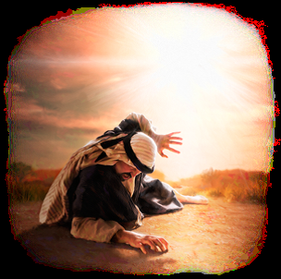
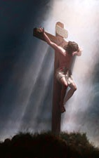
Conclusion
The power of compassion…
Was an example by the Samaritan (How to be a neighbor – Lk. 10:36-37)
Saved the world from sins and reconciled man to God in the death of Jesus (Jn. 1:29)
Saved Paul and exemplified the grace and mercy of God (I Tim. 1:13, 16)
Shown in action by the Shirley women who saved many lives and in so doing saved their plantation (Civil War, 1862)
When shown by us today we will be shown compassion on Judgment Day! (Mt. 5:7)

Slide 24
Conclusion
Show the power of compassion to those around you in
all that you say and do!

Slide 25
“What Must I Do To Be Saved?”
Hear The Gospel (Jn. 5:24; Rom. 10:17)
Believe In Christ (Jn. 3:16-18; Jn. 8:24)
Repent Of Sins (Lk. 13:35; Acts 2:38)
Confess Christ (Mt. 10:32; Rom. 10:10)
Be Baptized (Mk. 16:16; Acts 22:16)
Remain Faithful (Jn. 8:31; Rev. 2:10)
For The Erring Child:
Repent (Acts 8:22), Confess (I Jn. 1:9),
Pray (Acts 8:22)

