Slide 1
A Marriage That Works For The Lord
Text: Acts 18:2; I Cor. 16:19
Notes:
By Nathan L Morrison
All Scripture given is from NASB unless otherwise stated
For further study, or if questions, please Call: 804-277-1983 or Visit: www.courthousechurchofchrist.com

Slide 2
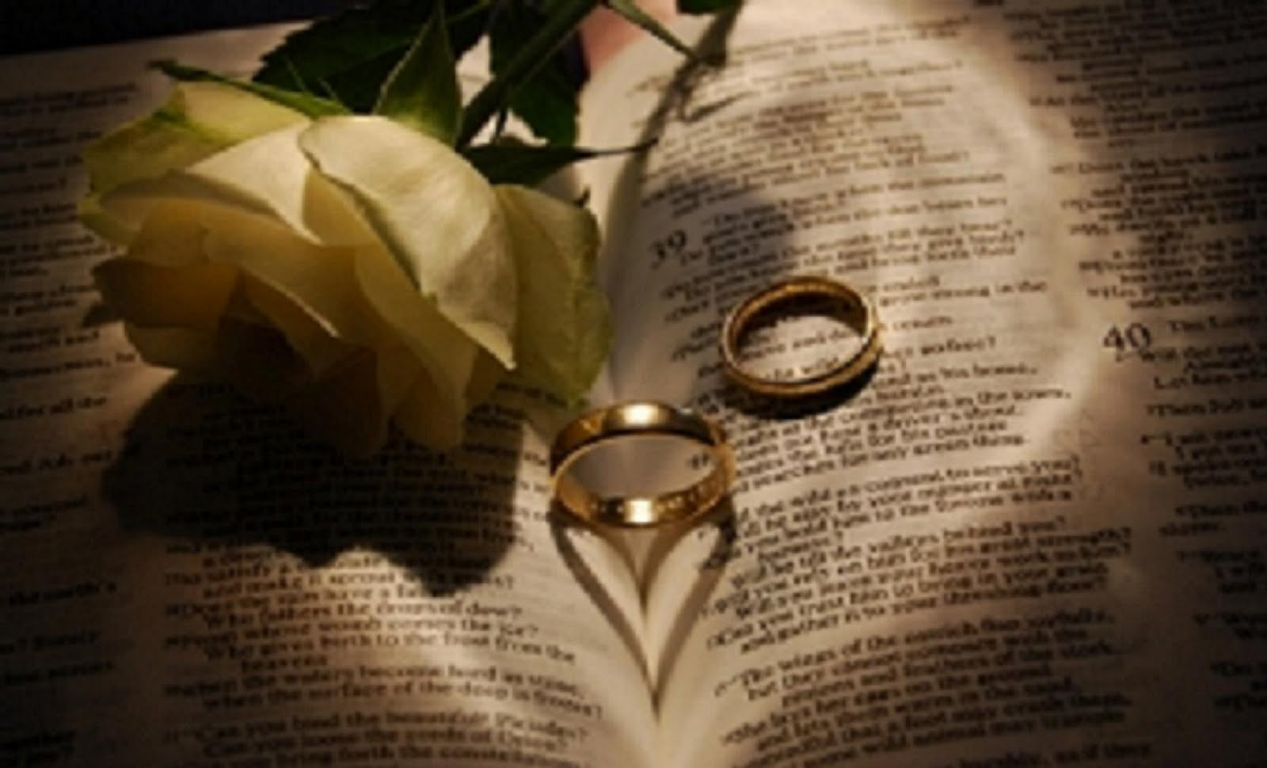
Intro
People recognize the importance of a marriage that works
Christian couples are to be concerned not only that
theirs is a marriage that works but that their
marriage works for the cause of Christ
Individually we are to seek first the kingdom of God – Mt. 6:33
Husbands & wives are “fellow heir(s) of the grace of life” – I Pet. 3:7
Elders and deacons are to be “family men” – I Tim. 3:1-13; Titus 1:6 (Wives play an important role in the managing of their homes)
Godly husbands & wives can be a force for good when they make their marriages work for the cause of Christ!

Slide 3
Intro
Aquila and Priscilla are a married couple that set a
godly example in making a marriage work for the
Lord
Not one word says they had spiritual gifts or that Aquila held offices in the church or was a preacher!
They were ordinary people who set different priorities than the world around them!
In their brief appearances
in the N.T. they show
saints today how to make
a marriage work for
the Lord!

Slide 4
Aquila & Priscilla: They Worked Together
Aquila and Priscilla are mentioned in N.T. six times and
always mentioned together!
Acts 18:2, 18, 26
2. And he found a Jew named Aquila, a native of Pontus, having recently come from Italy with his wife Priscilla, because Claudius had commanded all the Jews to leave Rome. He came to them,
18. Paul, having remained many days longer, took leave of the brethren and put out to sea for Syria, and with him were Priscilla and Aquila. In Cenchrea he had his hair cut, for he was keeping a vow.
26. and he began to speak out boldly in the synagogue. But when Priscilla and Aquila heard him, they took him aside and explained to him the way of God more accurately.

Slide 5
Aquila & Priscilla: They Worked Together
Aquila and Priscilla are mentioned in N.T. six times and
always mentioned together!
Rom. 16:3
3. Greet Prisca and Aquila, my fellow workers in Christ Jesus,
I Cor. 16:19
19. The churches of Asia greet you. Aquila and Prisca greet you heartily in the Lord, with the church that is in their house.
II Tim. 4:19
19. Greet Prisca and Aquila, and the household of Onesiphorus.

Slide 6
Aquila & Priscilla: They Worked Together
For a marriage to work for the Lord both spouses need to
have the same mind
Amos 3:3: Two can’t work together unless they are agreed!
Lk. 11:7: Jesus said a house divided against itself cannot stand!
Acts 18:2-3: They were both tent-makers and worked together!
I Cor. 16:19: They worked together in hosting the church in their house at Ephesus (I Cor. 16:8) and at Rome (Rom. 16:3-5)
Rom. 16:3-4: They not only worked together to make ends meet but shared in their spiritual goals as fellow workers with Paul (also risked their lives)!
Aquila & Priscilla worked
together in making their
marriage work for
the Lord!

Slide 7
Aquila & Priscilla: They Practiced Hospitality
The first mention of this couple is that they opened their home to Paul (Had some things in common with him)!
Acts 18:1-3
1. After these things he left Athens and went to Corinth.
2. And he found a Jew named Aquila, a native of Pontus, having recently come from Italy with his wife Priscilla, because Claudius had commanded all the Jews to leave Rome. He came to them,
3. and because he was of the same trade, he stayed with them and they were working, for by trade they were tent-makers.
They and Paul were Jews in a foreign city
They and Paul were both tent-makers by trade
They got along with Paul as when he left Corinth they went with him (18:18) and they stayed in Ephesus (18:19)
This hospitality and working with Paul allowed Paul to support himself and not be accused of preaching for money (II Cor. 11:5-9)

Slide 8
Aquila & Priscilla: They Practiced Hospitality
Aquila and Priscilla not only opened up their home to Paul but to the church
Church at Ephesus – I Cor. 16:8, 19 (II Tim. 4:19; cf. I Tim. 1:3)
Church at Rome – Rom. 16:3-5
Saints are told to practice hospitality (Rom. 12:13; Heb. 13:2; I Pet. 4:9)
“Hospitality” = philonexia [fil-on-ex-ee'-ah] (G5381): From G5382; hospitableness: - entertain strangers, hospitality; Lit. “Love of strangers”
Aquila & Priscilla were godly
examples of a hospitable
couple in making their
marriage work for the Lord!

Slide 9
Aquila & Priscilla: They Supported Preaching
Couples wanting to make their marriage work for the Lord should have a love of the gospel and for those who teach it! (Gospel Preachers)
At least two preachers were helped by Aquila & Priscilla
Paul
Took in Paul when he came to Corinth from Athens (Acts 18:1-3)
They were Paul’s “fellow workers” – Rom. 16:3-5
They “risked their own necks” for his life – Rom. 16:4
They “contributed(ing) to the needs of the saints, practicing hospitality” – Rom. 12:13
Apollos
Met Apollos in Ephesus (Acts 18:24-28: Synagogue)
They took him aside (privately) and corrected him
Apollos went on to be a great asset to Paul and for the cause of Christ (I Cor. 3:6; 16:12; Titus 3:13)

Slide 10
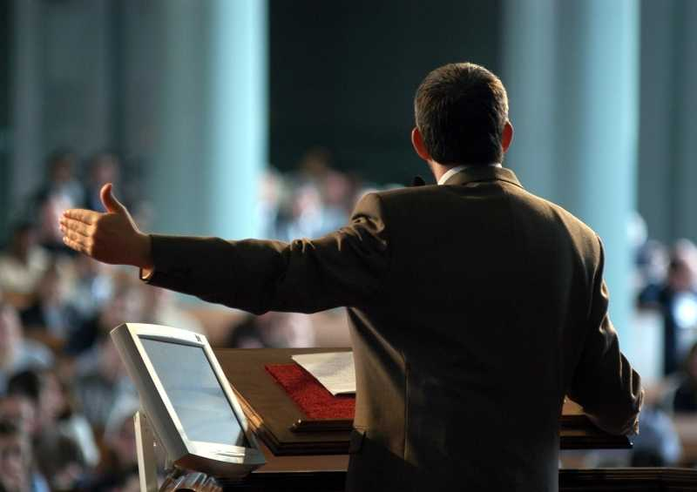
Aquila & Priscilla: They Supported Preaching
One way we can make our marriages work is by making evangelism a priority in our families!
Aquila & Priscilla were godly examples of supporting
preaching efforts in making their marriage work for the Lord!

Slide 11
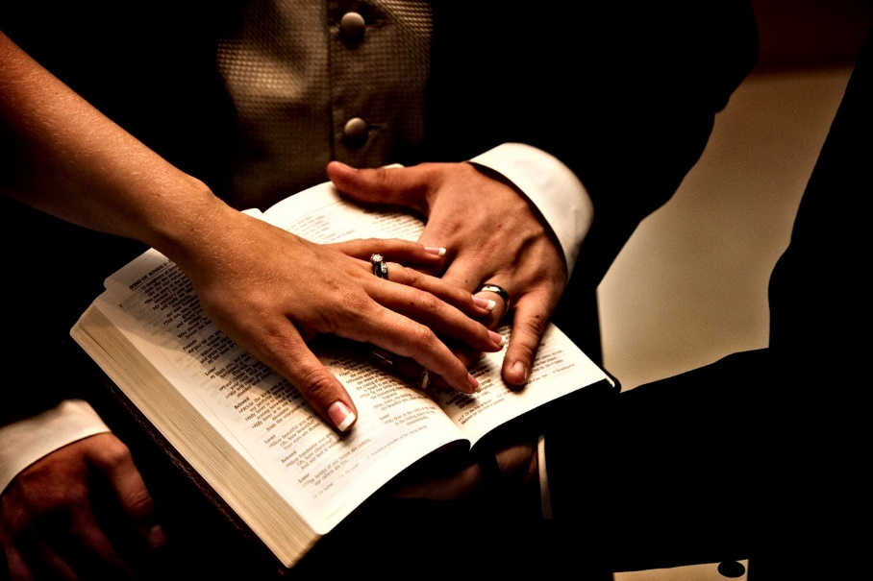
Conclusion
Spouses married to non-Christians can still serve the
Lord (Acts 16:1; II Tim. 1:5; 3:15) and may even
convert them (I Pet. 3:1-2)!
For a marriage to truly work for the Lord husbands & wives are not to only be “one flesh” (Mt. 19:5) but
to be of “one mind” (I Cor. 1:10; Phil. 1:27)
in spiritual things!
Aquila & Priscilla set a godly
example in showing how to
make a marriage work
for the Lord!

Slide 12
“What Must I Do To Be Saved?”
Hear The Gospel (Jn. 5:24; Rom. 10:17)
Believe In Christ (Jn. 3:16-18; Jn. 8:24)
Repent Of Sins (Lk. 13:35; Acts 2:38)
Confess Christ (Mt. 10:32; Rom. 10:10)
Be Baptized (Mk. 16:16; Acts 22:16)
Remain Faithful (Jn. 8:31; Rev. 2:10)
For The Erring Child of God:
Repent (Acts 8:22), Confess (I Jn. 1:9),
Pray (Acts 8:22)

