Slide 1
Marriage: Roles & Responses (Part 2)
Text: Gen. 2:18; Titus 2:3-5
Notes:
By Nathan L Morrison
All Scripture given is from NASB unless otherwise stated
For further study, or if questions, please Call: 804-277-1983 or Visit: www.courthousechurchofchrist.com
Based on a lesson by Joe Price and adapted from Preparing for Marriage by Dennis Rainey, editor, pp. 163-173

Slide 2
Intro
God established within marriage necessary roles & responses for it to flourish – Eccl. 9:9
God’s core role of husbands: Head of wife – Eph. 5:23
Christ loved the church & came as a Servant-Leader – Mk. 10:42-45
Husbands are to lead their families as Christ leads: As a Servant-Leader
God ordained that the husband is the head of the family (Gen. 1:27; 2:18, 21-22)
God’s core response of wife to headship: Submission
(Eph. 5:22-24; I Pet. 3:1-2, 5-6)
Submission does NOT mean a “Doormat” or “property of the husband!”
In submitting to the authority of her husband, a wife is submitting to the Lord's authority (As church submits to Lord)
This in itself should remove any attitude of reluctance or rebellion!

Slide 3
Intro
The Wife also has a core role in marriage; it defines
her essential place and her vital responsibility in
Marriage!
The Husband has a core response without which,
marriage is a burden to the wife, bitterness to the
husband and a battle in which there are no winners,
only losers!

Slide 4
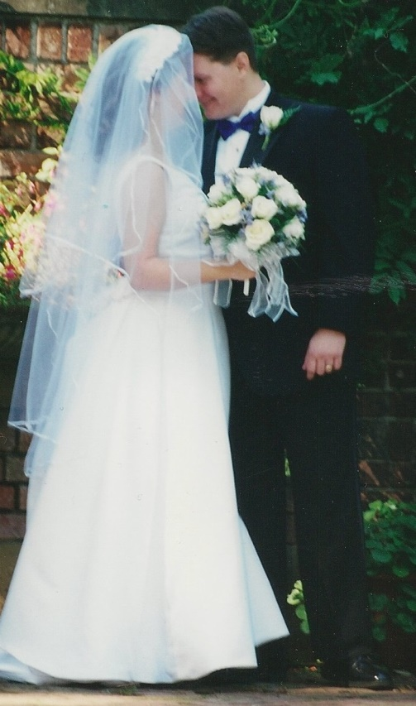
Intro
There are God-given roles of husband and wife;
and God-given responses to each one’s role!
It is critical for those wishing to enter
into marriage and for married couples
to understand that Scriptural roles and
responses are essential for marriage to
be what God wants it to be (Eccl. 9:9)!
Notes:
Image: Nate & Becky Morrison, Sept. 8th, 2001

Slide 5
GOD’S CORE ROLE OF THE WIFE: HELPER–HOMEMAKER
You are a Suitable Helper – Gen. 2:18 (KJV: “Help meet
for him;” NKJ: “Helper comparable to him;” ESV: “Helper
fit for him”)
Adam saw and named all the creatures God made – realized there was none like him (Gen. 2:19-20)
God uniquely made you to fill a role for your husband nobody else can! (Find fulfillment in being what God wants you to be!) – Gen. 2:18, 21-24
Notes:
Image: www.knowing-jesus.com

Slide 6
GOD’S CORE ROLE OF THE WIFE: HELPER–HOMEMAKER
You are a Suitable Helper – Gen. 2:18 (KJV: “Help meet
for him;” NKJ: “Helper comparable to him;” ESV: “Helper
fit for him”)
You complete, NOT compete against, your husband! (Prov. 31:11-12)
Competitors exploit weaknesses to gain the upper hand; helpers “fill in the gaps” and help support in weak areas
Prov. 19:13; 21:9, 19
Prov. 31:11-12
11. The heart of her husband trusts in her, And he will have no lack of gain.
12. She does him good and not evil All the days of her life.

Slide 7
GOD’S CORE ROLE OF THE WIFE: HELPER–HOMEMAKER
You are a Suitable Helper – Gen. 2:18 (KJV: “Help meet
for him;” NKJ: “Helper comparable to him;” ESV: “Helper
fit for him”)
A Helper is NOT inferior (Heb. 13:6); Expresses loving care and concern. (God is not our inferior, yet He helps us!)
A Helper comforts (Jn. 14:16-18). Encourage your husband; be his source of confidence, assurance and invigoration against the world’s harshness

Slide 8
GOD’S CORE ROLE OF THE WIFE: HELPER–HOMEMAKER
You are a Homemaker – Titus 2:3-5
(NAS” “workers at home;” NKJ: “homemakers;”
KJV: “keepers at home;” ESV: “working at home”)
Homemaker: oikouros [oy-koo-ros'] (G3626): From G3624 (home, house, household), guard, keeper, watcher; housekeeper, keeper at home
Lit. a house guard; “caring for the house,” “the (watch or) keeper of the house,” “domestic.” Guard the house (family) – not necessarily limited to a building – oikos G3624 means home, house(-hold), family
“The husband provides for the home
but the wife makes it a home!”
Can a wife work outside the house?

Slide 9
GOD’S CORE ROLE OF THE WIFE: HELPER–HOMEMAKER
You are a Homemaker – Titus 2:3-5
(NAS” “workers at home;” NKJ: “homemakers;”
KJV: “keepers at home;” ESV: “working at home”)
The Wife is to manage the house – I Tim. 5:14:
KJV: “guide the house;” NAS: “keep house; NKJ: “manage the house;” (ESV: “manage their household”) – G3616: rule a family, guide the house
This is NOT limited to a building or house chores!
She is to manage the house (I Tim. 5:14),
that is to guide the home (family)
Prov. 31:12, 15, 27

Slide 10
GOD’S CORE ROLE OF THE WIFE: HELPER–HOMEMAKER
A woman that works outside the house takes on an added
Responsibility (1st priority is to her family not her career)
Some women take jobs to help out their husbands in various ways: “Suitable Helper!”
family-owned businesses
husband in school/training for better job/career
finances tight
making ends meet (to help with bills)
husband injured or laid up/disabled
etc…
Some women take jobs because they don’t want to
be at home or to help out (Wrong Attitude!)
If a wife can work outside the home & still
“manage the house” she is pleasing to God!

Slide 11
GOD’S CORE ROLE OF THE WIFE: HELPER–HOMEMAKER
Warning: “That the Word of God may not be Blasphemed!”
– Titus 2:5 (NKJ)
The Wife’s role transcends fads and cultures! (God’s word stands despite not being popular in society today)
At stake is the organizational structure God created to make a marriage work!
The Wife who meets her role as Helper-Homemaker honors God!

Slide 12
GOD’S CORE ROLE OF THE WIFE: HELPER–HOMEMAKER
Wives, if you work outside the house, prioritize your family around your job, not the other way around!
Ultimately, her fulfilling her role of Helper-Homemaker
is an issue between the Wife and the Lord! (Titus 2:5)

Slide 13
GOD’S CORE RESPONSE OF THE HUSBAND: PRAISE AND HONOR
Praise and Honor are the Masculine Counterpart to Submission
Prov. 31:28-30
28. Her children rise up and bless her; Her husband also, and he praises her, saying:
29. "Many daughters have done nobly, But you excel them all."
30. Charm is deceitful and beauty is vain, But a woman who fears the LORD, she shall be praised.
Col. 3:19
19. Husbands, love your wives and do not be embittered against them.
I Pet. 3:7
7. You husbands in the same way, live with your wives in an understanding way, as with someone weaker, since she is a woman; and show her honor as a fellow heir of the grace of life, so that your prayers will not be hindered.

Slide 14
GOD’S CORE RESPONSE OF THE HUSBAND: PRAISE AND HONOR
Ways you can praise and honor your wife [cherish –
Eph. 5:28-29]:
OR, Reasons Why Wives Won’t Become Angry and Resentful Toward Their Husbands
Husband is caring toward her
Husband is appreciative of her
Husband is unselfish toward her
Husband is not lazy or passive in helping her
Husband has good listening habits
Husband has eyes only for her – Prov. 5:18

Slide 15
GOD’S CORE RESPONSE OF THE HUSBAND: PRAISE AND HONOR
“Show her honor” – I Pet. 3:7
“Weaker” doesn’t mean inferior – cherish and value (Eph. 5:28-30)!
She is NOT inferior – a “fellow heir of the grace of life”
Christian husband and Christian wife are also “brother and sister in Christ”
Husbands can treat their wives in a dishonorable way that will hinder their prayers, which will require repentance and forgiveness! (I Pet. 3:12)
Ultimately, his response of
praise and honor to her role
of Helper-Homemaker is an
issue between the Husband
and the Lord! (I Pet. 3:7)

Slide 16
Conclusion
Although the husband is called to lead
(Servant-Leader) and provide for the home
(Provider), the wife’s special role is to make it
a home!
The Husband’s challenge is to respond with praise and
honor for his wife (acknowledge her, understand her,
honor her)!

Slide 17
Conclusion
Husbands & Wives are both told to love one another
(Eph. 5:25, 28; Titus 2:4) – Love is a commandment
(NOT optional, or uncontrolled emotion)
Love means all that is included in I Corinthians 13!
Love is kind
Love will keep you from criticizing
or contradicting your spouse
in front of others
Love will keep you from
quarreling in front of
your children

Slide 18
Conclusion
Maintain absolute honesty in order to have a basis
of mutual confidence!
Keep lines of communication open!
Husbands and wives are joint-heirs
of eternal life (I Pet. 3:7)!
Let us strive to be the husbands and
wives God wants us to be!

Slide 19
“What Must I Do To Be Saved?”
Hear The Gospel (Jn. 5:24; Rom. 10:17)
Believe In Christ (Jn. 3:16-18; Jn. 8:24)
Repent Of Sins (Lk. 13:35; Acts 2:38)
Confess Christ (Mt. 10:32; Rom. 10:10)
Be Baptized (Mk. 16:16; Acts 22:16)
Remain Faithful (Jn. 8:31; Rev. 2:10)
For The Erring Child of God:
Repent (Acts 8:22), Confess (I Jn. 1:9),
Pray (Acts 8:22)

