Slide 1
Marriage: Communication (The Tie That Binds)
Text: Rom. 12:9-13, 16
Notes:
By Nathan L Morrison
All Scripture given is from NASB unless otherwise stated
For further study, or if questions, please Call: 804-277-1983 or Visit: www.courthousechurchofchrist.com
Based on a lesson by Joe Price and adapted from Growthtrac Marriage Minute (4/15/2011), RBC Ministries

Slide 2
Intro
Communication solves many misunderstandings and can reduce drama in relationships
Communication is a building block of any successful
Relationship…
God communicates to us all through His Son – Heb. 1:1-2; Acts 20:32
Children of God communicate with God the Father through prayer – Mt. 6:9
Parents and children must talk with each other – Eph. 6:4 (Mt. 7:9-11)
Husbands and wives must communicate effectively to strengthen the tie that binds (I Pet. 3:7) and reduce the drama in marriage…
Why do husbands and wives fail to
effectively communicate?

Slide 3
REASONS HUSBANDS AND WIVES DO NOT COMMUNICATE EFFECTIVELY…
They Begin Taking Each Other for Granted

Slide 4
They Begin Taking Each Other for Granted
Love does not assume or take for granted; it cherishes
and delights in the one it loves (SoS 2:3; 3:1-4)
When you love someone, you will do all you can to ensure the safety of that person and care for his or her needs, even at a cost to your personal comfort
Demonstrated most often in small actions
Notice what each does for the other and show appreciation
Ignore the World’s saying, “Familiarity breeds contempt” and abide by God saying get familiar and stay that way! – Gen 2:18, 24; Mt. 19:4-6
Song of Solomon 2:3
3. "Like an apple tree among the trees of the forest, So is my beloved among the young men. In his shade I took great delight and sat down, And his fruit was sweet to my taste.

Slide 5
REASONS HUSBANDS AND WIVES DO NOT COMMUNICATE EFFECTIVELY…
They Begin Taking Each Other for Granted
They Want to Avoid a Confrontation

Slide 6
They Want to Avoid a Confrontation
Past conflict can prevent present communication
(Prov. 21:9, 19)
Don’t react in negative ways! (Col 4:6)
Col. 4:6
6. Let your speech always be with grace, as though seasoned with salt, so that you will know how you should respond to each person.
Break the cycle of conflict,
silence and avoidance:
With a soft answer (Prov. 15:1-2), not in accusing tones.
By always thinking the best of each other (I Cor. 13:5)
By stopping the arguing and reconcile (Prov. 20:3; Mt. 5:23-24)
With a real commitment to listen to each other (Js. 1:19).
By removing wrath from your heart (Prov. 15:18; Eph. 4:31; Col. 3:8).

Slide 7
REASONS HUSBANDS AND WIVES DO NOT COMMUNICATE EFFECTIVELY…
They Begin Taking Each Other for Granted
They Want to Avoid a Confrontation
They are Obsessed with Their Own Interests

Slide 8
They are Obsessed with Their Own Interests
Sin of selfishness (no self-control – II Tim 3:3; Gal 5:23) – Phil 2:3-4
Phil. 2:3-4
3. Do nothing from selfishness or empty conceit, but with humility of mind regard one another as more important than yourselves;
4. do not merely look out for your own personal interests, but also for the interests of others.
How/where we spend our
time, money, interests, etc.
equates to value, devotion,
security and trust (Lk.
12:15; Mt. 16:26; I Cor.
13:5):
A Husband whose first concern is his own satisfaction is not following Christ (Eph. 5:25; I Tim 5:8)
A Wife whose first concern is her own pleasure is not following Christ (Eph. 5:22, 24; Prov. 31:27)

Slide 9
Solution/Goal
Solution:
Make effort to be interested in what interests your spouse (Eccl. 4:9-11)
Do things together! (Children, recreation, etc.)
Nurture your shared faith! (Study, pray together, etc.)
Goal:
Take time to notice and show appreciation for even the little things done for one another!
Make effort to communicate without conflict and reconcile to each other!
Do things together!

Slide 10
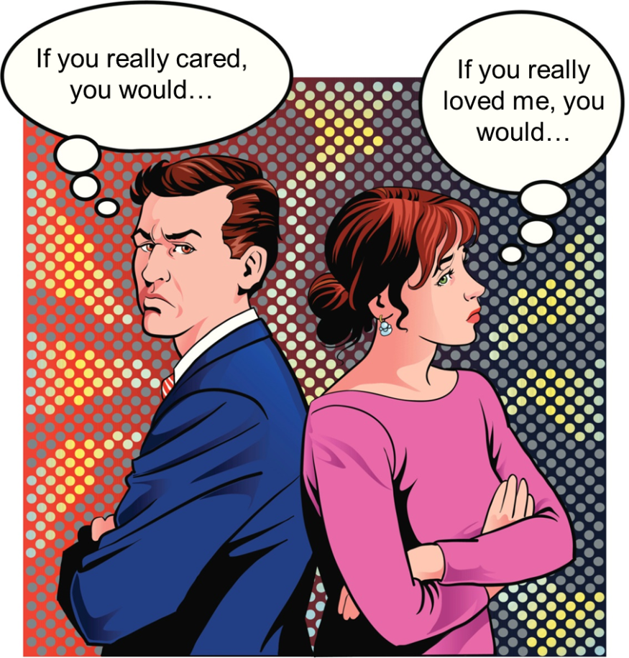
REASONS HUSBANDS AND WIVES DO NOT COMMUNICATE EFFECTIVELY…
They Feel That They are Being Manipulated

Slide 11
They Feel That They are Being Manipulated
Joke: “Husband is the head, but the wife is the neck that turns the head!” (she supports! – Gen. 2:18)
Why does a husband feel
like he is being manipulated?
Maybe he is!
Domineering wife…(I Pet. 3:3-6)
Not leading…(I Pet. 3:6)
Why does a wife feel like
she is being manipulated?
Maybe she is!
Husband pays attention when he wants something (I Pet. 3:7)
Contributes to resentment, distrust and animosity!
Rom. 12:10
10. Be devoted to one another in brotherly love; give preference to one another in honor;

Slide 12
REASONS HUSBANDS AND WIVES DO NOT COMMUNICATE EFFECTIVELY…
They Feel That They are Being Manipulated
They Say They are Too Busy to Take the Time

Slide 13
They Say They are Too Busy to Take the Time
Communication takes a commitment of time
(Eph. 5:16; Col 4:5-6)
“I have no time” can be an
easy excuse for couples to
close off their hearts from
one another!
We make time for things
we want to do – Make time
to attend to your
relationship by simply
talking to and listening to
each other!
Don’t be a “Martha” (Lk. 10:38-42)!
Eph. 5:16
16. making the most of your time, because the days are evil.

Slide 14
REASONS HUSBANDS AND WIVES DO NOT COMMUNICATE EFFECTIVELY…
They Feel That They are Being Manipulated
They Say They are Too Busy to Take the Time
They Don’t Want to Hurt the Other Person

Slide 15
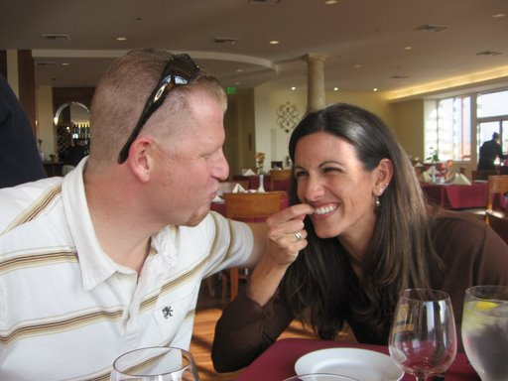
They Don’t Want to Hurt the Other Person
Do you want to help your spouse?
(Sometimes help hurts – “Truth Hurts”)
Humble hearts are
necessary in order to give
correction to and to receive
correction from our
spouses! (Rom 12:16)
Are you willing to accept help
from your spouse – even if it
exposes your shortcoming,
fault or sin?
Rom. 12:16
16. Be of the same mind toward one another; do not be haughty in mind, but associate with the lowly. Do not be wise in your own estimation. .

Slide 16
Solution/Goal
Solution:
Spouses must help each other know that they always have each other’s best interest at heart
(I Cor. 13:5; Eph. 5:33; Col. 3:18-19).
Goal:
Show preference to each other!
Take time out for each other (talking, recreation, hobbies, etc.)
Strengthen each other and help each other go to heaven!
Communication is the key to
strengthening the tie that binds
and reducing drama and stress
from your marriage!

Slide 17
Conclusion
A marriage without communication is like a car
without fuel; it won’t go very far for very long…
it will sputter and die!

Slide 18
Conclusion
Rom. 12:9-13, 16: Communication will be the natural
product of building our marriages on…
Sincerity (without hypocrisy) and Goodness – 12:9
Kind Affection (NKJ) and Preference to one another in Honor – 12:10
Diligent Service (to each other and to the Lord) – 12:11
Joyful Hope, Persevering in Trials and Prayer – 12:12
Sympathetic Giving (Hospitality) and Unity – 12:13, 16
Rom. 12:9-13, 16
9. Let love be without hypocrisy. Abhor what is evil; cling to what is good.
10. Be devoted to one another in brotherly love; give preference to one another in honor;
11. not lagging behind in diligence, fervent in spirit, serving the Lord;
12. rejoicing in hope, persevering in tribulation, devoted to prayer,
13. contributing to the needs of the saints, practicing hospitality.
16. Be of the same mind toward one another; do not be haughty in mind, but associate with the lowly. Do not be wise in your own estimation.

Slide 19
Conclusion
GOAL
PUT GOD FIRST IN YOUR MARRIAGE (Col. 3:12-19)
MAKE YOUR SPOUSE'S WELL BEING YOUR PRIORITY (I Cor. 13:5; Phil. 2:4)
BECOME GOOD COMMUNICATORS (Prov. 15:1-2; Js. 1:19-20; Eph. 4:29)
NEVER REFUSE TO FORGIVE EACH OTHER (Col. 3:12-14)
Old Saying, “Forget injuries. Never forget kindness!”
Make time to communicate with your spouse as it will
strengthen your marriage and reduce drama, stress,
and conflict!
Let us strive to be the husbands and wives
God wants us to be!

Slide 20
“What Must I Do To Be Saved?”
Hear The Gospel (Jn. 5:24; Rom. 10:17)
Believe In Christ (Jn. 3:16-18; Jn. 8:24)
Repent Of Sins (Lk. 13:35; Acts 2:38)
Confess Christ (Mt. 10:32; Rom. 10:10)
Be Baptized (Mk. 16:16; Acts 22:16)
Remain Faithful (Jn. 8:31; Rev. 2:10)
For The Erring Child of God:
Repent (Acts 8:22), Confess (I Jn. 1:9),
Pray (Acts 8:22)

