Slide 1
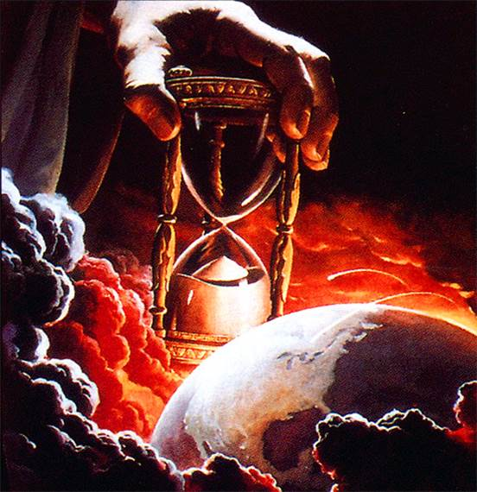
Power Of God's Word: “Upholds All Things”
Text: Heb. 1:3
Notes:
By Nathan L Morrison
All Scripture given is from NASB unless otherwise stated
For further study or if questions, Call: 804-277-1983 or Visit: www.courthousechurchofcrist.com

Slide 2
Intro
The Scriptures “cannot be broken” (Jn. 10:35), and are complete! (II Tim. 3:17; II Pet. 1:3)
Men have the tendency to underestimate the power of God’s word
Naaman (II Kings 5)
The rich man in torments (Lk. 16:27-31)
Many Jews of Jesus’ & Paul’s day (Jn. 4:48; I Cor. 1:22-24)
Men are still minimizing the power and completeness of God’s word!

Slide 3
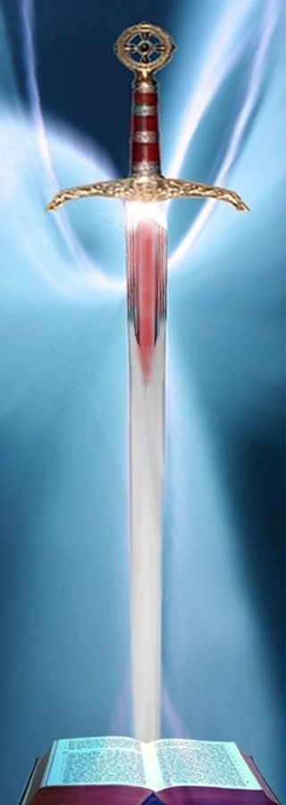
Intro
Don’t underestimate the power of God’s word!
Hebrews 1:3
3. And He is the radiance of His glory and the exact representation of His nature, and upholds all things by the word of His power. When He had made purification of sins, He sat down at the right hand of the Majesty on high,
Hebrews 4:12
12. For the word of God is living and active and sharper than any two-edged sword, and piercing as far as the division of soul and spirit, of both joints and marrow, and able to judge the thoughts and intentions of the heart.

Slide 4
Intro
Men need to be constantly reminded of the Power of God’s word!

Slide 5
Power of the Word of God
Spoken word of God
How powerful is it?
So powerful that God spoke the world into existence

Slide 6
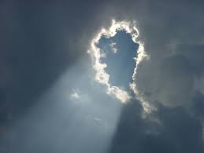
Power of the Word of God
Hebrews 11:3
3. By faith we understand that the worlds were prepared by the word of God, so that what is seen was not made out of things which are visible.
Psalm 33:9
(Gen. 1:1; Ex. 20:11)
9. For He spoke, and it was done; He commanded, and it stood fast.

Slide 7
Power of the Word of God
Spoken word of God
How powerful is it?
So powerful that God spoke the world into existence (Heb. 11:3; Ps. 33:9; Heb. 1:2; Col. 1:13-16; Jn. 1:3)
So powerful as to cause fear and awe and can keep one from sin & idolatry (Exodus 19-20)

Slide 8
Power of the Word of God
Spoken word of God
God spoke the world into existence
Can keep one from sin & idolatry
Written word of God
How powerful is it?
It can withstand Satan! (Mt. 4:1-11)

Slide 9
Power of the Word of God
Matthew 4:10-11 (Vss. 1-11)
10. Then Jesus said to him, "Go, Satan! For it is written, 'YOU SHALL WORSHIP THE LORD YOUR GOD, AND SERVE HIM ONLY.'"
11. Then the devil left Him; and behold, angels came and began to minister to Him.

Slide 10
Power of the Word of God
Spoken word of God
God spoke the world into existence
Can keep one from sin & idolatry
Written word of God
How powerful is it?
It can withstand Satan! (Mt. 4:1-11)
Could prevent the rich man’s five brothers from going to the place of torment (Lk. 16:19-31, esp. vs. 29-31)

Slide 11
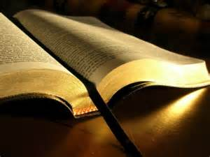
Power of the Word of God
Spoken word of God
Written word of God
The word of God, both spoken and written, is powerful to create and save souls!

Slide 12
Power of the Word of Jesus
Spoken word of Jesus
How powerful is it?
Powerful enough to sustain the universe and keep it operating!

Slide 13
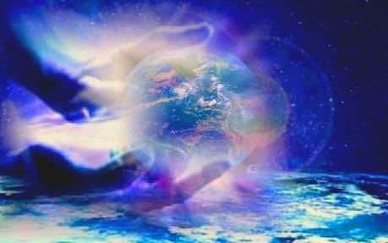
Power of the Word of Jesus
Hebrews 1:3 (Col. 1:16-17; Jn. 1:1-3)
3. And He is the radiance of His glory and the exact representation of His nature, and upholds all things by the word of His power. When He had made purification of sins, He sat down at the right hand of the Majesty on high,

Slide 14
Power of the Word of Jesus
Spoken word of Jesus
How powerful is it?
Create and sustain the universe – Heb. 1:3; Col. 1:16-17; Jn. 1:1-3
Heal immediately – Lk. 7:1-10; Jn. 4:43-53
Control the weather – Mk. 4:35-41
Raise the dead – Lk. 7:14; Jn. 11:43; Lk. 8:54; Jn. 10:17-18 (Lk. 24:5-6)

Slide 15
Power of the Word of Jesus
Spoken word of Jesus
Written word of Jesus
How powerful is it?
One could have life by believing the written record of it!

Slide 16
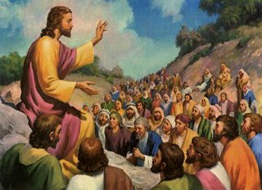
Power of the Word of Jesus
John 20:30-31 (Jn. 3:16: “Eternal Life”)
30. Therefore many other signs Jesus also performed in the presence of the disciples, which are not written in this book;
31. but these have been written so that you may believe that Jesus is the Christ, the Son of God; and that believing you may have life in His name.

Slide 17
Power of the Word of Jesus
Spoken word of Jesus
Written word of Jesus
How powerful is it?
Eternal life by believing it! (John 20:30-31)
Can lead one to know “all truth!” (Jn. 16:13; II Tim. 3:16-17; Heb. 1:1-2)
Can be understood! (Eph. 3:4-7)
Has the power to save! (Rom. 1:16)
Eternal and Judges (Jn. 12:48)

Slide 18
Power of the Word of God
Spoken word of Jesus
Written word of Jesus
At Christ’s word all things were created (Ps. 33:6, 9), at His word all things are sustained (Heb. 1:3), & at His word all things will be burned (I Thess. 4:16-18; II Pet. 3:10-12)!

Slide 19
Conclusion
There is no difference in the power of
God’s spoken word and His written word!
Lk. 16:29, 31: The written word of God in
Moses and the prophets could prevent the rich
man’s brothers from torment, so can the
written message of Christ prevent us from such
a fate!

Slide 20
Conclusion
James 1:21 (Hebrews 2:1-4: Word confirmed)
21. Therefore, putting aside all filthiness and all that remains of wickedness, in humility receive the word implanted, which is able to save your souls.

Slide 21
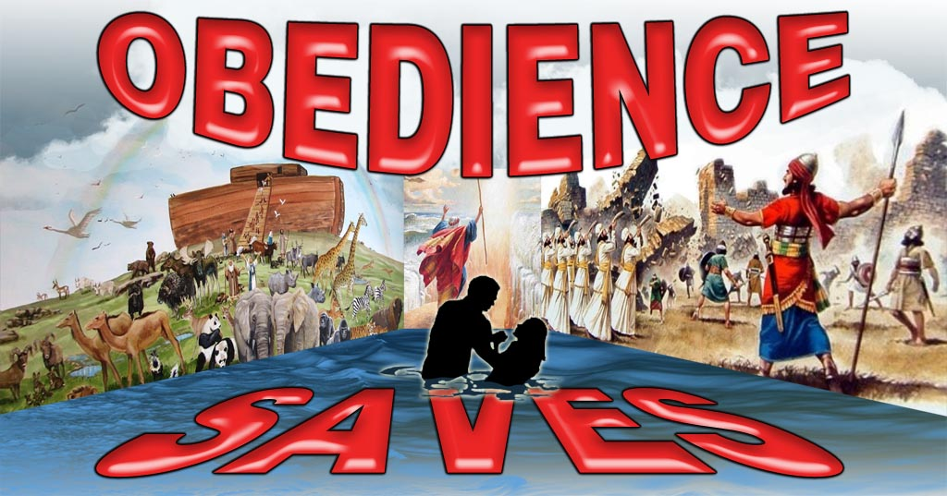
Conclusion
How will you respond to the word of God?

Slide 22
“What Must I Do To Be Saved?”
Hear The Gospel (Jn. 5:24; Rom. 10:17)
Believe In Christ (Jn. 3:16-18; Jn. 8:24)
Repent Of Sins (Lk. 13:35; Acts 2:38)
Confess Christ (Mt. 10:32; Rom. 10:10)
Be Baptized (Mk. 16:16; Acts 22:16)
Remain Faithful (Jn. 8:31; Rev. 2:10)
For The Erring Child:
Repent (Acts 8:22), Confess (I Jn. 1:9),
Pray (Acts 8:22)

