Slide 2
The Whole Counsel of God
“For I have not shunned to declare to you the whole counsel of God.”
Acts 20:27
“For by grace you have been saved through faith, and that not of yourselves; it is the gift of God,” Ephesians 2:8
Richie Thetford www.thetfordcountry.com

Slide 3
The Whole Counsel Involves:
Difficult Things
Acts 20:19-20
2 Corinthians 11:24-28
Serious Things
Acts 20:26
Beneficial Things
Acts 20:20
Doctrinal Things
Acts 19:1-5
Richie Thetford www.thetfordcountry.com

Slide 4
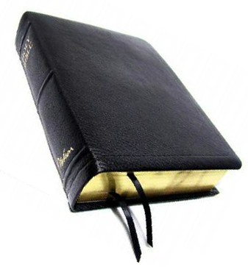
Saved by Grace through Faith
What Did the Ephesians Do?
Heard and Believed
Ephesians 1:13
Repented
Acts 20:21
Baptized
Acts 19:1-5
THE WHOLE COUNSEL OF GOD
Richie Thetford www.thetfordcountry.com

Slide 5
GRACE - FAITH - WORKS
“By faith the walls of Jericho fell down after they were encircled for seven days.” (Hebrews 11:30)
Joshua 6:2 – “Grace” – Given
Joshua 6:20 – “Work” is the result of “Faith”
The city was given by GRACE. The walls fell by FAITH after WORKS (obedience)
PRINCIPLE:
Doing what God commands does not
take away from Grace or Faith
THE WHOLE COUNSEL OF GOD
Richie Thetford www.thetfordcountry.com

Slide 6
GRACE - FAITH - WORKS
“So he went down and dipped seven times in the Jordan, according to the saying of the man of God; and his flesh was restored like the flesh of a little child, and he was clean.”
(2 Kings 5:14)
GRACE: Your leprosy will be cleansed
FAITH: Hearing and trusting in the message of God
WORK: Dipped 7 times and was cleansed
“Cleansed AFTER Obedience”
THE WHOLE COUNSEL OF GOD
Richie Thetford www.thetfordcountry.com

Slide 7
Denominational Error
“We are accounted righteous before God only for the merit of our Lord and Savior Jesus Christ, by faith, and not for our own works or deserving. Wherefore, that we are justified by faith only is a most wholesome doctrine and very full of comfort” {Discipline of The Methodist Church, page 28}
BIBLE: Blessings come when faith has issued into works of obedience
“You see then that a man is justified by works, and not by faith only.” (James 2:24)
THE WHOLE COUNSEL OF GOD
Richie Thetford www.thetfordcountry.com

Slide 8
Denominational Error
“We believe the Scriptures teach that salvation of sinners is wholly of grace…” {p.61}
“…eternal life…is bestowed, not in consideration of any works of righteousness which we have done, but solely through faith in Christ…” {p.62} {The Standard Manual for Baptist Churches}
BIBLE:
GRACE + FAITH + WORKS (Obedience) = Salvation {Hebrews 11:30; 2 Kings 5}
THE WHOLE COUNSEL OF GOD
Richie Thetford www.thetfordcountry.com

Slide 9
Salvation Principle Applied New Testament Example (Acts 16:30-34)
“And he brought them out and said, "Sirs, what must I do to be saved?“ So they said, "Believe on the Lord Jesus Christ, and you will be saved, you and your household.“ Then they spoke the word of the Lord to him and to all who were in his house. And he took them the same hour of the night and washed their stripes. And immediately he and all his family were baptized. Now when he had brought them into his house, he set food before them; and he rejoiced, having believed in God with all his household.”
GRACE + FAITH + WORKS (Obedience)
THE WHOLE COUNSEL OF GOD
Richie Thetford www.thetfordcountry.com

