Slide 2
Success Comes to Those
Who Rely on the Lord
2 Chronicles 14-16
“For whatever things were written before were written for our learning, that we through the patience and comfort of the Scriptures might have hope.” Romans 15:4
Richie Thetford www.thetfordcountry.com

Slide 3
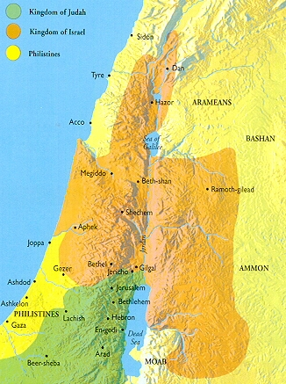
The Setting
The Divided Kingdom in the year 911 B.C.
Asa becomes the 3rd king of Judah, the grandson of Rehoboam
Asa reigns for 41 years
Asa was a man that did
“what was good and right in the eyes of the LORD his God”
Richie Thetford www.thetfordcountry.com

Slide 4
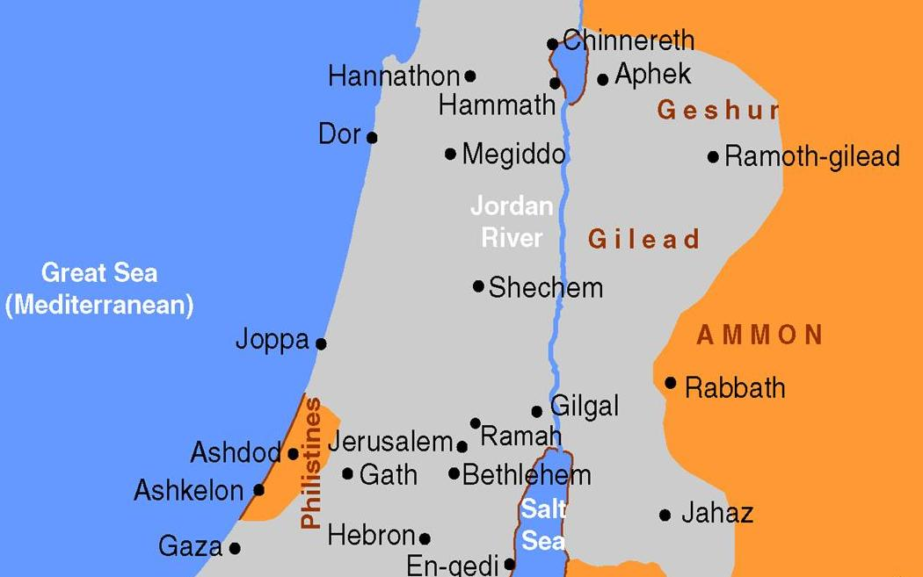
ASA
Richie Thetford www.thetfordcountry.com

Slide 5
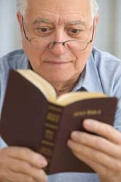
ASA
35 years of faithful service to God
6 years of unfaithful service
Result
End to his reign
End to his life
A missed opportunity to be faithful to the end
Richie Thetford www.thetfordcountry.com

Slide 6
Lessons Learned
Seek God
Matthew 6:33
We will find rest for our souls
Matthew 11:28-30
Be prepared to tear down “the high places!”
Richie Thetford www.thetfordcountry.com

Slide 7
Lessons Learned
Don’t Forget God
When we encounter trials in life
James 1:3
When He has made a promise
2 Peter 3:4-5
When we encounter temptations
1 Corinthians 10:13
Richie Thetford www.thetfordcountry.com

Slide 8
An Autobiography of Life
(1 Corinthians 10:13)
Chapter ONE
I walk down the street. There is a deep hole in the sidewalk. I fall in. I am lost ... I am hopeless. It isn’t my fault. It takes forever to find a way out.
Chapter TWO
I walk down the same street. There is a deep hole in the sidewalk. I pretend I don’t see it. I fall in again. I can’t believe I am in the same place. But, it is not my fault. It still takes a long time to get out.
Chapter THREE
I walk down the same street. There is a deep hole in the sidewalk. I see it is there. I still fall in ... it is a habit. My eyes are open, I know where I am. It is my fault. I get out immediately.
Chapter FOUR
I walk down the same street. There is a deep hole in the sidewalk. I walk around it.
Chapter FIVE
I walk down another street.

Slide 9
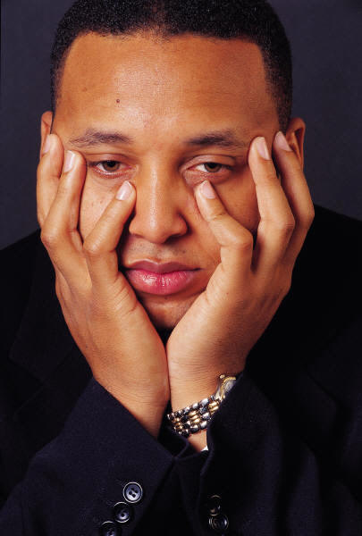
Lessons Learned
A Child of God CAN Fall From Grace
1 Corinthians 10:12
2 Peter 2:20
Romans 11:22
Richie Thetford www.thetfordcountry.com

Slide 10
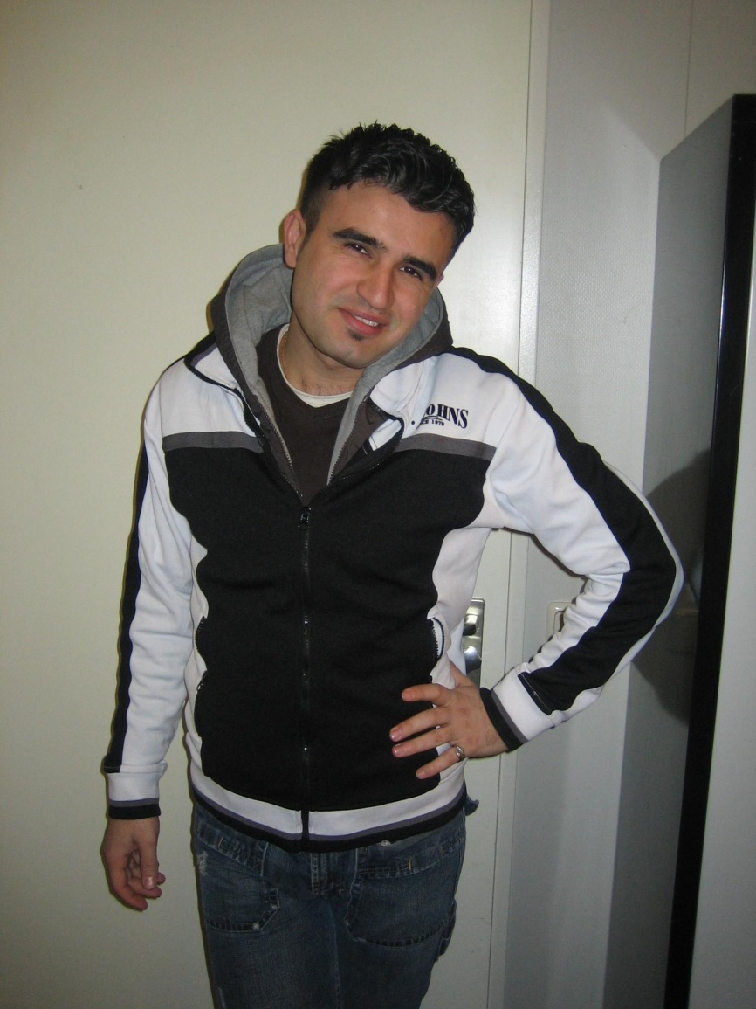
Lessons Learned
Pride Leads to Destruction
Proverbs 11:2
Proverbs 16:18
Proverbs 29:23
Richie Thetford www.thetfordcountry.com

Slide 11
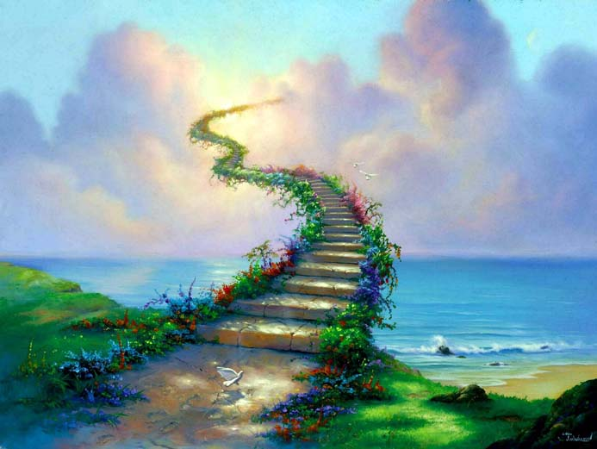
Lessons Learned
Remain Loyal to the End!
1 Corinthians 15:58
Matthew 7:13-14
Richie Thetford www.thetfordcountry.com

