Slide 1
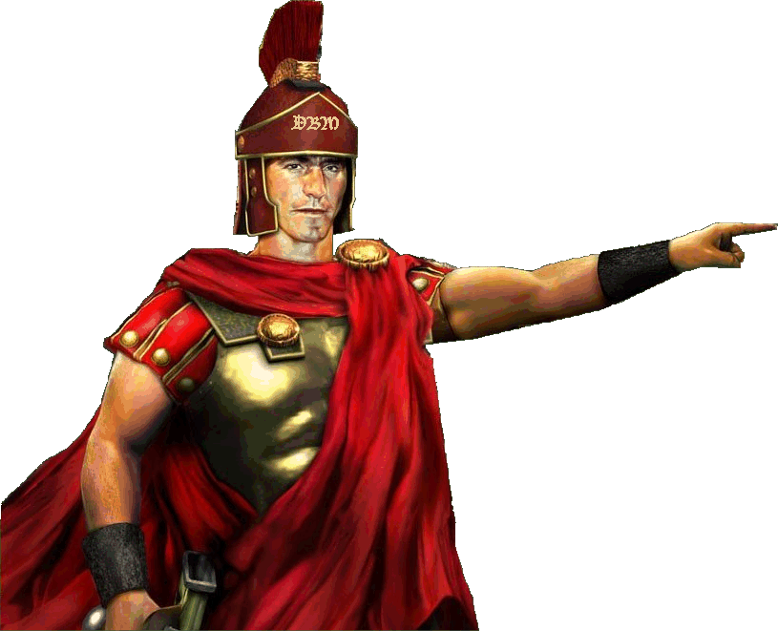
Why Send For Peter? Text: Acts 10:5
Notes:
By Nathan L Morrison
All Scripture given is from NASB unless otherwise stated
For further study or if questions, Call: 804-277-1983 or Visit: www.courthousechurchofcrist.com
Based on a Tract by Johnnie Edwards

Slide 2
Intro
A popular teaching on baptism is that it is not essential for salvation:
Either it’s optional, mandatory, or not necessary altogether.
Many teach it is an outward appearance of an inward grace (Not found in Scripture).
Also, it is taught that it is the entrance into a particular denomination
The Word of God teaches that it is:
Mt. 28:19; Mk. 16:16; Jn. 3:5; Acts 2:38; 22:16; Rom. 6:3-6; Gal. 3:27; I Pet. 3:21

Slide 3
Intro
The conversion of Cornelius challenges popular teachings on salvation today!
Acts 10:5
5. "Now dispatch some men to Joppa and send for a man named Simon, who is also called Peter;
“Why send for the apostle Peter?”

Slide 4
Why Send for Peter…?
If “Morally Right” Saves?
Acts 10:1-2
1. Now there was a man at Caesarea named Cornelius, a centurion of what was called the Italian cohort,
2. a devout man and one who feared God with all his household, and gave many alms to the Jewish people and prayed to God continually.
Lots of people think that doing “good works” justifies
one before God and saves (Mt. 7:21-23)
Notes:
Emphasis in Scripture mine!

Slide 5
Why Send for Peter…?
If Saying a Prayer Saves?
Acts 10:2
2. a devout man and one who feared God with all his household, and gave many alms to the Jewish people and prayed to God continually.
Popular teaching today is that a prayer will save souls,
but that is not taught anywhere in the Scriptures!
Notes:
Emphasis in Scripture mine!

Slide 6
Why Send for Peter…?
If Angels Preach to Men?
Muhammad – 610 AD: Islam, the Koran (Gal. 1:6-9)
Joseph Smith – 1830 AD: Book of Mormon (Gal. 1:6-9)
Acts 10:3 (Acts 10:3-8)
3. About the ninth hour of the day he clearly saw in a vision an angel of God who had just come in and said to him, "Cornelius!"
I Cor. 1:21: It is the gospel that saves and
God designed it to be preached, not by
angels, but by men (Mt. 28:18-20)
Notes:
Emphasis in Scripture mine!

Slide 7
Why Send for Peter…?
If Men Are Saved by Visions?
Acts 10:3
3. About the ninth hour of the day he clearly saw in a vision an angel of God who had just come in and said to him, "Cornelius!"
There are people who claim to have seen visions and this
is their confirmation that they have been saved –
Didn’t save Cornelius!
Notes:
Emphasis in Scripture mine!

Slide 8
Why Send for Peter…?
If Holy Spirit Baptism Saves?
Acts 10:44-46
44. While Peter was still speaking these words, the Holy Spirit fell upon all those who were listening to the message.
45. All the circumcised believers who came with Peter were amazed, because the gift of the Holy Spirit had been poured out on the Gentiles also.
46. For they were hearing them speaking with tongues and exalting God. Then Peter answered,
Prevalent teaching today is that the only baptism that saves is Holy Spirit baptism!
Notes:
Emphasis in Scripture mine!

Slide 9
Why Send for Peter…?
If Holy Spirit Baptism Saves?
Acts 11:15-18
15. "And as I began to speak, the Holy Spirit fell upon them just as He did upon us at the beginning.
16. "And I remembered the word of the Lord, how He used to say, 'John baptized with water, but you will be baptized with the Holy Spirit.'
17. "Therefore if God gave to them the same gift as He gave to us also after believing in the Lord Jesus Christ, who was I that I could stand in God's way?"
18. When they heard this, they quieted down and glorified God, saying, "Well then, God has granted to the Gentiles also the repentance that leads to life."
Notes:
Emphasis in Scripture mine!

Slide 10
Why Send for Peter…?
If Holy Spirit Baptism Saves?
The Holy Spirit baptism was a sign to the Jews that the message was from God (Acts 2), and here again it was a sign to the Jews (Peter and company) that God saves Gentiles as well as the Jews! (Acts 10:34-35)

Slide 11
Why Send for Peter…?
If “Morally Right” Saves?
If Saying a Prayer Saves?
If Angels Preach to Men?
If Men Are Saved by Visions?
If Holy Spirit Baptism Saves?
Why send for Peter if Cornelius could have been saved in these supernatural ways?

Slide 12
Why Send for Peter?
Cornelius Needed to Hear the Word of God
Acts 10:30-33: When God answered his prayer He didn’t preach to him but had him send for a preacher to hear what God commanded!
Acts 11:12-14: Peter recounted the words of the angel who told Cornelius to have Peter “’brought here; and he will speak words to you by which you will be saved, you and all your household.’”

Slide 13
Why Send for Peter?
Hearing is the first step in conversion:
Acts 2:22: “Men of Israel, listen to these words…”
Rom. 10:14: “…How will they believe in Him whom they have not heard? And how will they hear without a preacher?”
Rom. 10:17: “So faith comes from hearing, and hearing by the word of Christ (KJV, NKJ: “God”). (Sound words come from Christ – I Tim. 6:3)
Acts 15:7-9: Peter said, “…by my mouth the Gentiles would hear the word of the gospel and believe.”
The words Cornelius heard from Peter are recorded in
Acts 10:34-43

Slide 14
Why Send for Peter?
Men Are Saved by Gospel Preaching (Acts 11:13-14)
Acts 11:13-14: Peter would speak the words that save!
I Cor. 1:21: The gospel saves and God designed it to be preached, not by angels or directly by the Holy Spirit, but by men (Mt. 28:18-20: “Go” & “Teach”) from the words inspired by the Holy Spirit!
Rom. 1:16: The gospel “is the power of God for salvation” (II Thess. 2:14: Gospel calls).
Cornelius had to first hear the gospel to “call upon the
name of the Lord” (Joel 2:32; Acts 2:21; Rom. 10:13)
and how would he “hear without a preacher?”
(Rom. 10:14)

Slide 15
Why Send for Peter?
Obedience is Necessary (Acts 10:47-48)
Once the word is preached men must decide to obey or not (Felix: Acts 24:24-27; Agrippa: 26:27-28)
Heb. 5:9: “He became to all those who obey Him the source of eternal salvation.” (Mt. 7:21; Jn. 14:15)
Cornelius’ conversion, the first Gentile convert, ended
the same way as all NT conversions, in obedience to
the gospel by baptism! (Acts 10:48)

Slide 16
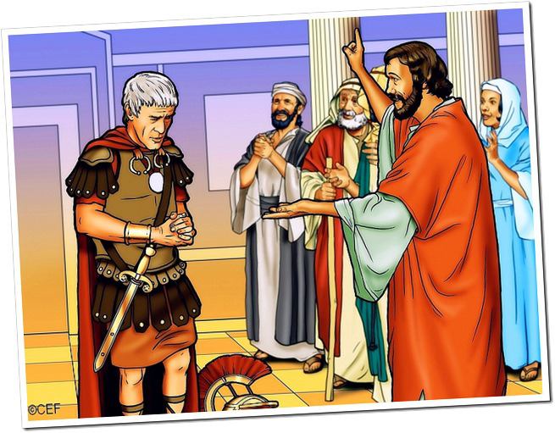
Why Send for Peter?
Repentance is Commanded (Acts 11:18)
Acts 17:30; II Pet. 3:9: “All men everywhere are commanded to repent!”
Cornelius repented – Acts 11:18

Slide 17
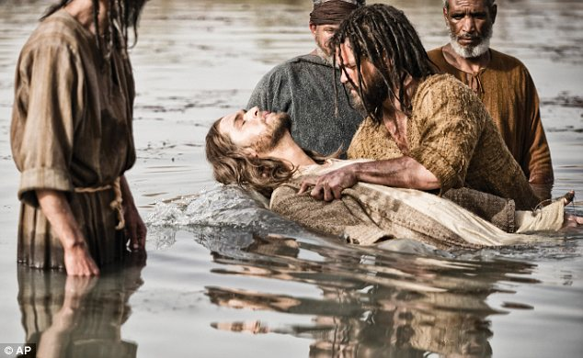
Why Send for Peter?
Baptism Saves! (Acts 10:47-48)
I Pet. 3:21: “Baptism now saves us.”
Acts 10:47-48: He “ordered them to be baptized in the name of Christ” (Not an option!)
Acts 22:16: Ananias was sent by God to Saul of Tarsus (Acts 9:10-12) and he told him to “Get up and be baptized, and wash away your sins, calling on His name.”
Cornelius and his household “called
on the name of the Lord” as
prescribed by God, through baptism
– Mk. 16:16; Acts 2:38

Slide 18
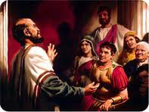
Why Send for Peter?
Cornelius Needed to Hear the Word of God
Men Are Saved by Gospel Preaching
Obedience is Necessary
Repentance is Commanded
Baptism Saves!
Peter was sent to Cornelius to give him a chance to
hear and obey the gospel to be saved!

Slide 19
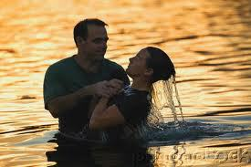
Conclusion
Acts 10:33, 47-48; 11:14, 18:
Cornelius and his household heard, believed, repented
and were baptized in the name of Christ!

Slide 20
Conclusion
Baptism is essential to salvation (Mk. 16:16):
Just as belief (Jn. 3:16; Rom. 10:17), repentance (Acts 2:38), and confession of faith (Acts 8:37; Rom. 10:10) are necessary in order for one to be saved!
One of those alone will not do it!
Jesus Himself said, “He who has believed and has been baptized shall be saved” (Mk. 16:16)

Slide 21
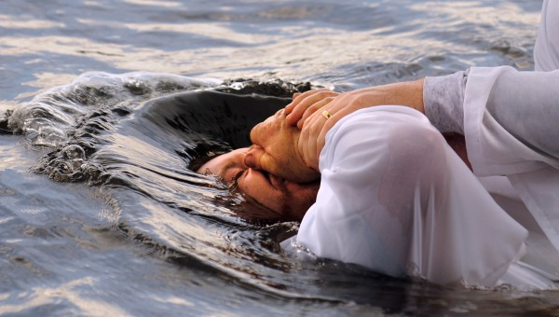
Conclusion
If you have not made the decision Cornelius and his household made, why not obey the gospel now, recognizing that “now is ‘THE DAY OF SALVATION!’”
(II Cor. 6:2)

Slide 22
“What Must I Do To Be Saved?”
Hear The Gospel (Jn. 5:24; Rom. 10:17)
Believe In Christ (Jn. 3:16-18; Jn. 8:24)
Repent Of Sins (Lk. 13:35; Acts 2:38)
Confess Christ (Mt. 10:32; Rom. 10:10)
Be Baptized (Mk. 16:16; Acts 22:16)
Remain Faithful (Jn. 8:31; Rev. 2:10)
For The Erring Child:
Repent (Acts 8:22), Confess (I Jn. 1:9), Pray (Acts 8:22)

