Slide 1
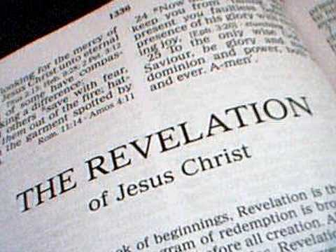
Jesus Christ Unveiled Text: Revelation 1
Notes:
By Nathan L Morrison
All Scripture given is from NASB unless otherwise stated
For further study or if questions, Call: 804-277-1983 or Visit: www.courthousechurchofcrist.com

Slide 2
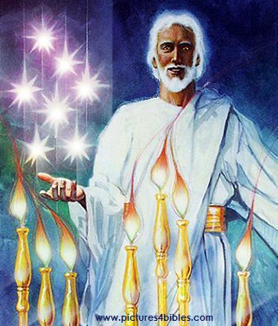
Intro
Rev. 1:1
1. The Revelation of Jesus Christ, which God gave Him to show to His bond-servants, the things which must soon take place; and He sent and communicated it by His angel to His bond-servant John,
Revelation = The “unveiling,” the apokalupsis [ap-ok-al'-oop-sis] (G602): disclosure, unveiling, to reveal
Revelation 1 contains many titles and pictures of Christ unveiled!

Slide 3
Jesus Christ Unveiled
Rev. 1:1: “The revelation of Jesus Christ”
“Christ” is “Christos” (G5547) : “Anointed One,” the equivalent to “Messiah” (Jn. 1:41: H4899).
Jesus is:
God’s final prophet to mankind – Heb. 1:1-3 (Acts 3:22-26)
God’s High Priest to saints – Heb. 4:14-16; 7:25
King of kings and Lord of lords – I Tim. 6:15; Rev. 19:16

Slide 4
Jesus Christ Unveiled
Rev. 1:5: “Faithful Witness”
Rev. 3:14; Jn. 18:37
Rev. 1:5: “Firstborn of the dead”
Not first person ever raised from death (I Kings 17:22; II Kings 4:32, 35; 13:21)
“Firstborn” = prōtotokos [pro-tot-ok'-os] (G4416): “the primary one, the preeminent one, firstborn; foremost, primary, chief.” (See Col. 1:15-17)

Slide 5
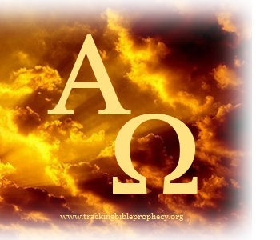
Jesus Christ Unveiled
Rev. 1:5: “Ruler of the Kings of the Earth” (Ps. 89:27):
Mt. 28:18; Jn. 18:37; 19:11
I Tim. 6:15; Rev. 19:6; Mt. 25:31-46
Rev. 5:1-14
Rev. 1:8: “I am the Alpha and the Omega”
Omniscient!
He is the source of all knowledge, the source of all truth, the source of all wisdom!

Slide 6
Jesus Christ Unveiled
Rev. 1:8: “Who is and who was and who is to come, the Almighty”
Jn. 1:1-2; Heb. 13:8
Omnipotent!
(Mt. 25:41-46; Rev. 1:16; 20:11-15)
Rev. 1:13: “Son of Man”
(Mt. 8:20; 9:6; 16:27; etc…)
Heb. 2:14-18
He identifies with the King of Daniel’s prophecy (Dan. 7:13-14)

Slide 7
Jesus Christ Unveiled
Rev. 1:17-18: “I am the first and the last”
1:18: “…the Living One”
He is the Creator and Consummator!
Mt. 25:31-46; Rev. 20:11-15: He has the keys and controls what happens to people when they die.
Incomprehensible power, incomprehensible authority!

Slide 8
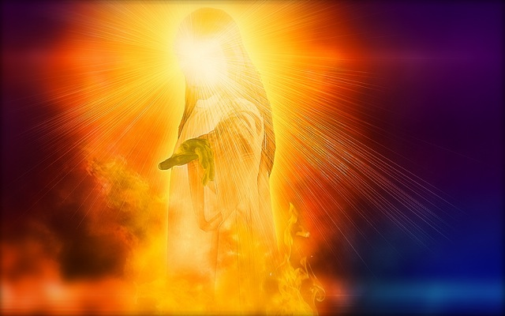
Jesus Christ Unveiled
“The revelation of Jesus Christ”
“Faithful Witness”
“Firstborn of the dead”
“Ruler of the Kings of the Earth”
“I am the Alpha and the Omega”
“Who is and who was and who is to come, the Almighty”
“Son of Man”
“The first and the last”
This is the unveiled Christ!

Slide 9
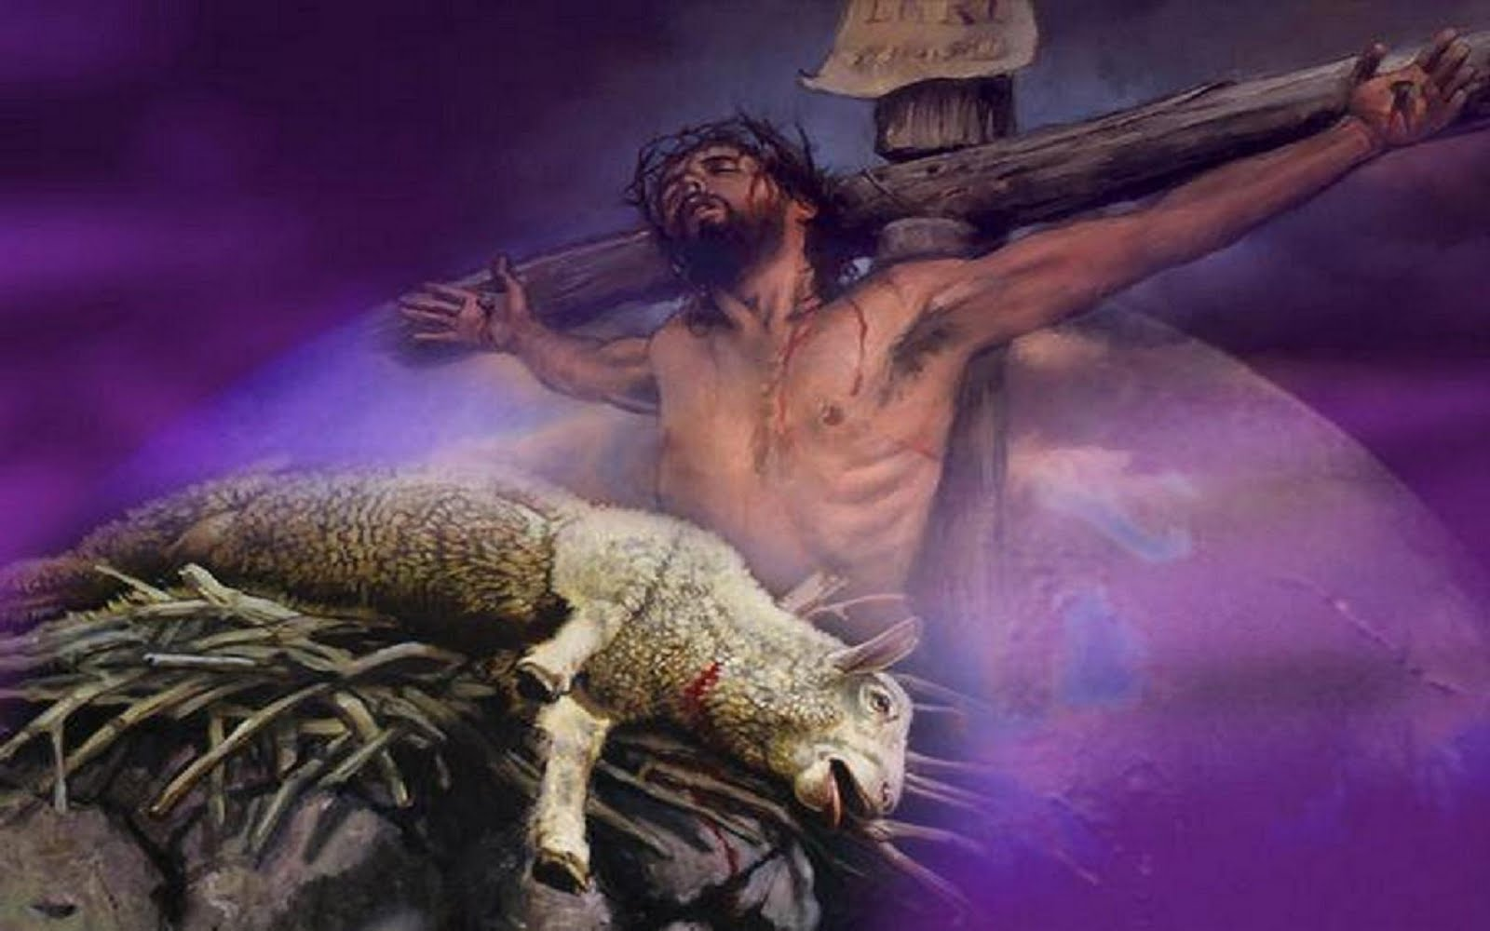
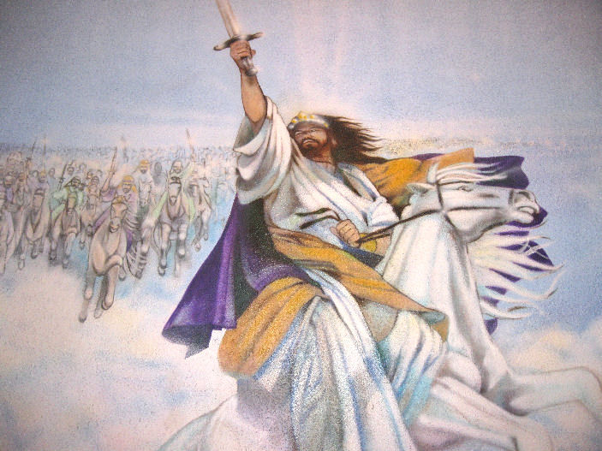
Conclusion
The first time Jesus came it was to save man from sin as a sacrificial Lamb; but when He comes again it is as a
conquering King and Judge!

Slide 10
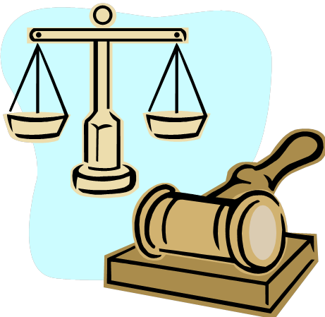
Conclusion
He holds reward and punishment in His hands!
This is the unveiled Christ!
The world doesn’t see Him now.
Just as the world didn’t accept Him in His time (Jn. 1:10-11), today they reject and mock the One who came to save them from their sins! (II Pet. 3:3-4)

Slide 11
Conclusion
But the day is coming when “every eye will see Him” (Rev. 1:7) and will fall on their knees in praise of Him (Phil. 2:10-11) and recognize He has the power over their souls’ eternity!
It doesn’t have to be a surprise! Rev. 1:1!

Slide 12
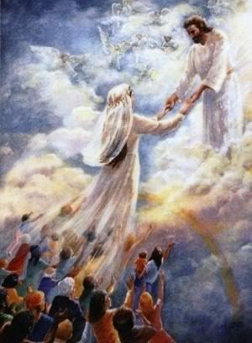
Conclusion
At His 2nd Coming saints will be like Him and see Him as He is (I Jn. 3:2) and will be with Him for eternity! (Jn. 14:3; I Thess. 4:17)
You don’t have to be surprised with the world at His return, but see Christ unveiled NOW!

Slide 13
“What Must I Do To Be Saved?”
Hear The Gospel (Jn. 5:24; Rom. 10:17)
Believe In Christ (Jn. 3:16-18; Jn. 8:24)
Repent Of Sins (Lk. 13:35; Acts 2:38)
Confess Christ (Mt. 10:32; Rom. 10:10)
Be Baptized (Mk. 16:16; Acts 22:16)
Remain Faithful (Jn. 8:31; Rev. 2:10)
For The Erring Child:
Repent (Acts 8:22), Confess (I Jn. 1:9),
Pray (Acts 8:22)

