Slide 1
Christ: "Appointed Heir Of All Things" Text: Heb. 1:1-4
Notes:
By Nathan L Morrison
All Scripture given is from NASB unless otherwise stated
For further study or if questions, Call: 804-277-1983 or Visit: www.courthousechurchofcrist.com

Slide 2
Heb. 1:1-4
1. God, after He spoke long ago to the fathers in the prophets in many portions and in many ways,
2. in these last days has spoken to us in His Son, whom He appointed heir of all things, through whom also He made the world.
3. And He is the radiance of His glory and the exact representation of His nature, and upholds all things by the word of His power. When He had made purification of sins, He sat down at the right hand of the Majesty on high,
4. having become as much better than the angels, as He has inherited a more excellent name than they.

Slide 3
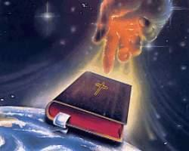
Intro
Man often underestimates the power
And importance of God’s words
Naaman wanted a miracle instead of obeying God’s word – II Kings 5
The rich man wanted one to return from the dead to warn his brothers – Lk. 16:27-31

Slide 4
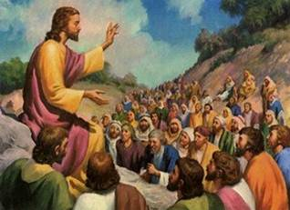
Intro
God’s word (written and spoken) is powerful (Heb. 4:12)
God has spoken in His Son,
and man needs to listen!

Slide 5
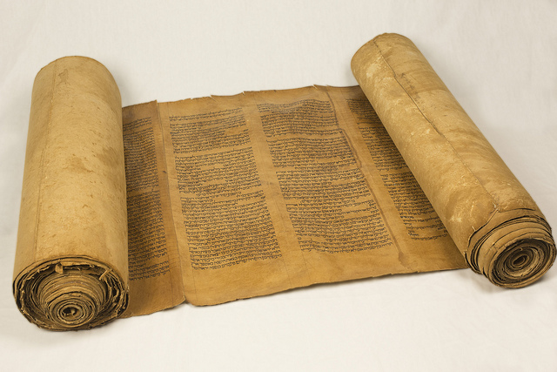
The Prophets and the Son
(Heb. 1:1-2) The prophets were God’s spokesmen – II Pet. 1:16-21
Their message was from God (II Pet. 1:20-21; Jn. 16:13; II Tim. 3:16).
Their message was “in many ways” – Heb. 1:1
Their message looked toward the coming of “The Prophet” – Acts 3:22-24

Slide 6
The Prophets and the Son
God has spoken in His Son, Jesus
“Heir of all things” & “all authority” (Heb. 1:1; Mt. 28:18)
Creator of the world (Heb. 1:2-3; Col. 1:16-17)
Sustains creation (Heb. 1:3; Col. 1:17)
Came as Fully God, fully man (Phil. 2:5-8)
Sinless life (II Cor. 5:21; I Jn. 3:5)
Made “purification of sins” (Heb. 1:3; 9:24-28)

Slide 7
The Prophets and the Son
God has spoken in His Son
Superior to the angels (Heb. 1:4)
God called Christ, “My Son” and commanded men to “listen to Him” (Heb. 1:5; II Pet. 1:17-18; Mt. 17:5)
God commanded angels to worship Him (Heb. 1:6)
Christ’s word will outlast the heavens and the earth (Mt. 24:35; Jn. 12:48)
Sits at the right hand of God (Heb. 1:3, 13; Acts 2:33; 5:31; 7:55; Rom. 8:34; Eph. 1:20; Col. 3:1)

Slide 8
The Prophets and the Son
God’s message through His Son is superior
to that of the prophets!
(He is a greater spokesman)

Slide 9
“Many Ways” and the Son
(Heb. 1:1-2)
God spoke to the fathers by the prophets in “different ways” (NKJV)
Amos & Hosea to Israel (Northern Kingdom)
Jonah to Nineveh (Capital of Assyria).
Isaiah & Jeremiah to Judah (Southern Kingdom)
Haggai & Zephaniah to the returned exiles
The prophets were sent by God for a specific purpose!

Slide 10
“Many Ways” and the Son
God’s Son spoke for all mankind of every time period (Jn. 12:48; Acts 17:30-31)
All men have sinned & need salvation – Rom. 3:23; 6:23
Christ has the “words of eternal life” – Jn. 6:68 (Jn. 16:13: Sent Holy Spirit)
Christ makes men complete – Col. 2:9-10
(II Pet. 1:1-4)

Slide 11
“Many Ways” and the Son
God has spoken in His Son and His word is
final and complete! (Heb. 1:1-2; Jude 3)

Slide 12
The Binding Word of God and the Son
The word spoken by angels was binding – Heb. 2:1-2
Sodom and Gomorrah – Genesis 19
The Law of Moses (ordained by angels) – Acts 7:53
Samson’s birth and Nazirite life – Judges 13
John the Baptist born and named – Luke 1
Jesus’ birth by Mary, a virgin – Luke 1

Slide 13
The Binding Word of God and the Son
The word spoken by the prophets was binding (Lk. 16:29, 31; Mt. 22:40; 26:56)
Samuel to Saul: Saul’s death – I Samuel 28
Elijah on Mt. Carmel: Contest between God and false gods – I Kings 18
Elisha to Naaman: Leprosy Healed – II Kings 5
One who transgressed the Law
of Moses died without mercy (Heb. 10:28)

Slide 14
The Binding Word of God and the Son
Peter used three cases to prove God
means what He says (II Pet. 2:4-6):
God did not spare sinful angels
God did not spare the sinful world
God did not spare Sodom & Gomorrah

Slide 15
The Binding Word of God and the Son
If God’s word was binding when He
spoke by angels & in “many ways” by the prophets, it is much more binding when spoken through His Son!
How can men escape if they “neglect so great a salvation?” (Heb. 2:2-4)
There is no other sacrifice for sins! (Heb. 10:11-12)
It will be severe for the one who “trampled underfoot the Son of God” (Heb. 10:29).

Slide 16
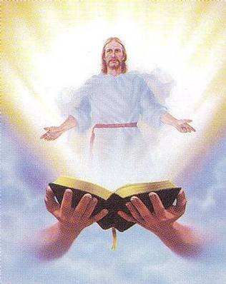
The Binding Word of God and the Son
God’s word is final and men must
listen to His Son! (Mt. 17:5; Jn. 12:48)

Slide 17
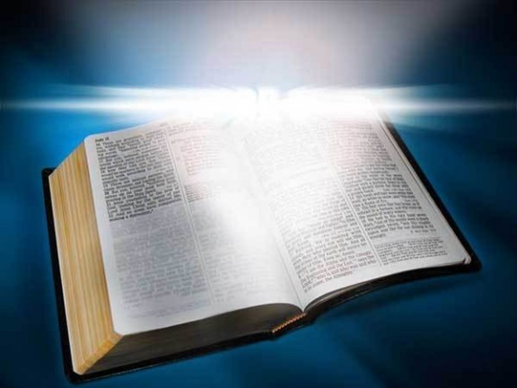
Conclusion
God has spoken:
By prophets in “many ways”
In these last days in His Son
If God meant what He said by the prophets, He surely means what He says through His Son
Mt. 25: 31-34, 41, 46

Slide 18
Conclusion
As “heir of all things” it is Jesus Christ mankind needs to listen to!
Respect the word of God and Christ! (Heb. 1:1-4)
Be obedient to Christ’s word of salvation! (Heb. 5:9; Js. 1:21)
Be faithful to Christ! (Jn. 8:31-32)

Slide 19
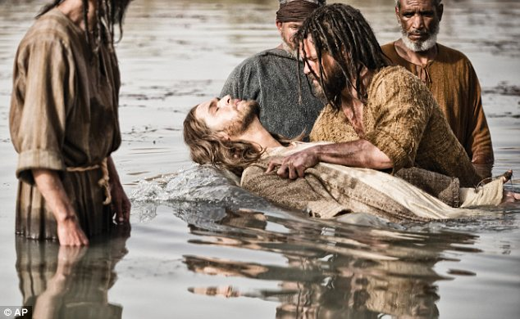
Conclusion
Have you listened to and obeyed the word of the Son? (Mt. 17:5)

Slide 20
“What Must I Do To Be Saved?”
Hear The Gospel (Jn. 5:24; Rom. 10:17)
Believe In Christ (Jn. 3:16-18; Jn. 8:24)
Repent Of Sins (Lk. 13:35; Acts 2:38)
Confess Christ (Mt. 10:32; Rom. 10:10)
Be Baptized (Mk. 16:16; Acts 22:16)
Remain Faithful (Jn. 8:31; Rev. 2:10)
For The Erring Child of God:
Repent (Acts 8:22), Confess (I Jn. 1:9),
Pray (Acts 8:22)

