Slide 1
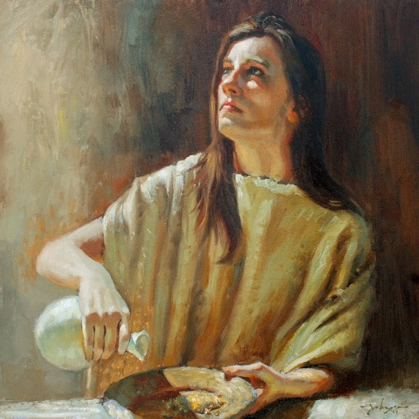
Give To God First
Text: I Kings 17:10-16
Notes:
By Nathan L Morrison
All Scripture given is from NASB unless otherwise stated
For further study or if questions, Call: 804-277-1983, or Visit: www.courthousechurchofchrist.com

Slide 2
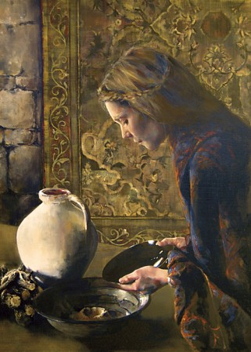
Intro
The Widow of Zarephath – I Kings 17:10-16
Famine struck, she was preparing to die with her son after one last meal.
Elijah asked her for water, and then to feed him first!
In an incredible show of faith, she did it!
She trusted in God and gave to Him first by taking care of His prophet!
God blessed her and her family with
food so they did not starve during the
famine.
Notes:
Image:
Widow of Zarephath painting by James Johnson

Slide 3
Intro
The widow’s example is a
picture of what God asked of
Israelites: Give to God first!
Israelites to give God the first of all they had! (Ex. 13:2; 34:19; Lev. 23:10, 17).
All their many offerings, burnt offerings (Lev. 1:10), grain offerings (Lev. 2:1), fellowship offerings (Lev. 3:1), guilt offerings (Lev. 5:15, 18), and sin offerings (Lev. 9:2-3), had to be the best!
Mal. 1:6-14: God, through Malachi, said they gave their leftovers to Him!
They robbed God!
Notes:
Image:
Widow of Zarephath painting by James Johnson

Slide 4
Intro
Luke 4:25-26
25. "But I say to you in truth, there were many widows in Israel in the days of Elijah, when the sky was shut up for three years and six months, when a great famine came over all the land;
26. and yet Elijah was sent to none of them, but only to Zarephath, in the land of Sidon, to a woman who was a widow.

Slide 5
Intro
Mt. 6:33
33. "But seek first His kingdom and His righteousness, and all these things will be added to you.
Jesus asks of His disciples what God asked of the Israelites under the Old Law, to give to God first!
Setting priorities allows us to give to God first!
By “seeking first the Kingdom of God” we give to God first in a variety of ways!

Slide 6
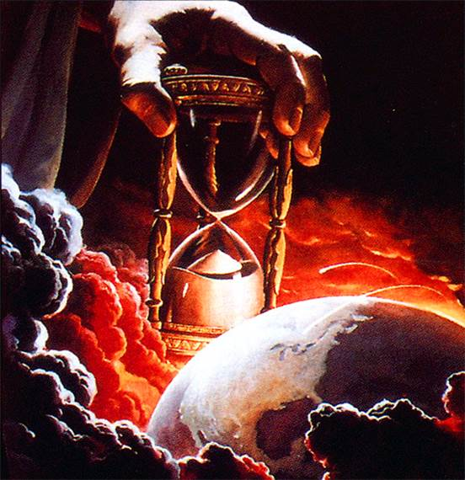
Give to God First: Time
Js. 4:14: Time in this life is short
Multitudes are using their time for selfish things
Saints can forget that their life is not their own, they are bought with a price, the precious blood of Jesus (I Cor. 6:20; I Pet. 1:18-19)
Eph. 5:16; Col. 4:5: We are to be “making the most of our time”
Js. 4:14
14. Yet you do not know what your life will be like tomorrow. You are just a vapor that appears for a little while and then vanishes away.

Slide 7
Give to God First: Time
We must give first to God of our Time:
Praying: Mk. 1:35; I Thess. 5:17
Studying: Acts 17:10-11
Working: I Cor. 15:58
Our time should be devoted first to God then to
other pursuits, and we will be blessed!

Slide 8
Give to God First: Talents
Jn. 6:27
27. "Do not work for the food which perishes, but for the food which endures to eternal life, which the Son of Man will give to you, for on Him the Father, God, has set His seal."
Each one is given talents “according
to his own ability” (Mt. 25:15; Rom. 12:6; I Cor. 12:11, 18; Eph. 4:7)

Slide 9
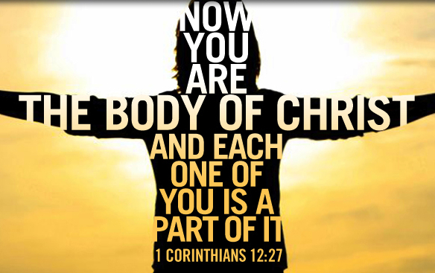
Give to God First: Talents
We must give first to God of our Talents:
There are many ways we can serve God and many abilities we can use to do it! (Rom. 12:4-15; I Cor. 12:4-31; Eph. 4:14-16).
Some have the ability to encourage (be a Barnabas – Acts 4:36-37; Heb. 10:25), to motivate, to teach, preach, lead songs, publicly speak, pray, maintain the building in an orderly way, help others (Dorcas – Acts 9:36-42), etc.

Slide 10
Give to God First: Talents
Your ability is God’s gift to you, what you do with it is your gift back to God!
We must use them or lose them! (Mt. 25:28)
Our talents (abilities) should be used to glorify God,
and to be a blessing to others!

Slide 11
Give to God First: Treasures
Lk. 12:15
15. Then He said to them, "Beware, and be on your guard against every form of greed; for not even when one has an abundance does his life consist of his possessions."

Slide 12
Give to God First: Treasures
Mt. 6:19-21
19. "Do not store up for yourselves treasures on earth, where moth and rust destroy, and where thieves break in and steal.
20. "But store up for yourselves treasures in heaven, where neither moth nor rust destroys, and where thieves do not break in or steal;
21. for where your treasure is, there your heart will be also.

Slide 13
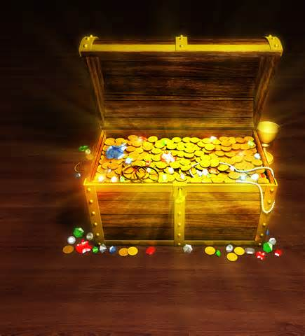
Give to God First: Treasures
We must give first to God of our Treasures:
Saints should give freely to assist the less fortunate (II Cor. 8:1-5)
Saints ought to give “as he prospered” (I Cor. 16:1-2)
Saints ought to give “as he has purposed in his heart” (II Cor. 9:7)
Do we give God the leftovers?
Or like the widow of Sidon
(I Kings 17:10-16) and the widow who gave her last mite to God (Mk. 12:41-44),
do we trust Him to take care of us?

Slide 14
Give to God First: Treasures
Sowing and reaping law applies to our giving (II Cor. 9:6)!
We are pleasing to God when we give
back from a cheerful heart as we’ve prospered!

Slide 15
Conclusion
God is the Creator, the Giver of all good things – Js. 1:17
(“For I am a great King” Mal. 1:14)
What a privilege to be able to give back a portion of the blessings He bestows upon us!
Christ gave everything for us (Acts 20:28), and asks that
we deny ourselves and follow Him (Mt. 16:24), and to give
back cheerfully (Acts 20:35)!

Slide 16
Conclusion
Jesus said to “seek first His kingdom and His
righteousness” and our physical needs will be supplied
(Mt. 6:33; II Cor. 8:5; Mk. 12:44)!
Do we first give ourselves to the Lord like the Sidonian
widow and the Macedonians?

Slide 17
Conclusion
Are we laying up treasures in Heaven or here on earth?
(Mt. 6:19-21; I Tim. 6:17-19)
Let us purpose in our hearts not to rob God
but to give back cheerfully and to give to Him first!

Slide 18
“What Must I Do To Be Saved?”
Hear The Gospel (Jn. 5:24; Rom. 10:17)
Believe In Christ (Jn. 3:16-18; Jn. 8:24)
Repent Of Sins (Lk. 13:35; Acts 2:38)
Confess Christ (Mt. 10:32; Rom. 10:10)
Be Baptized (Mk. 16:16; Acts 22:16)
Remain Faithful (Jn. 8:31; Rev. 2:10)
For The Erring Child:
Repent (Acts 8:22), Confess (I Jn. 1:9), Pray (Acts 8:22)

