Slide 1
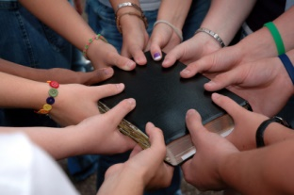
Fellowship In The Gospel Text: I John 1:3-4
Notes:
By Nathan L Morrison
All Scripture given is from NASB unless otherwise stated
For further study or if questions, Call: 804-277-1983, or Visit: www.courthousechurchofchrist.com

Slide 2
Intro
“Koinos” (G2839) in the N.T. can properly be defined as
“sharing something with someone, an associate, partner,
companion, partaker”
Luke 5:10: James and John were “partners” with Peter (G2844 koinonos)
Heb. 2:14: Jesus, in order to destroy the power of Satan over mankind, shared with man “flesh and blood” that He might deliver man through His death – “Share” (G2841 koinoneo).
II Pet. 1:4: We become “partakers” (sharers) of the divine nature – “Partakers” (G2844)
Notes:
Full Text from the Outline:
A. The Greek root word “koinos” (G2839) in the N.T. can properly be defined as “sharing something with someone, an associate, partner, companion, partaker.”
1. It denotes a partnership in work (a profession), such as Peter shared with James and John in the fishing business – Luke 5:10: “Partners” (G2844 koinonos).
2. It is used to express a common relationship or nature. Jesus, in order to destroy the power of Satan over mankind, shared with man “flesh and blood” that He might deliver man through His death and destroy the power of Satan over him –Heb. 2:14: “Share” (G2841 koinoneo).
3. We become “partakers” (sharers) of the divine nature through the precious promises of God and the provisions of His grace – II Pet. 1:4: “Partakers” (G2844 koinonos)
4. The Gentiles became “partakers” of the “rich root” (the full nature) of the olive tree when they were “grafted” in as branches and shared such fullness with the Jews – Rom. 11:17: “Partaker” (G4791 sugkoinōnos [soong-koy-no-nos']: From G4862 (sun) and G2844 (koinonos); a co-participant: partaker). Eph. 3:4-6
5. We are enabled to enjoy “fellowship” with the Apostles and with God and Christ through the Gospel – I Jn. 1:3: “Fellowship” (G2842 koinōnia: Partnership, lit. participation).
6. Through the blood of Christ and walking in His light, we have fellowship with God and with one another – I Jn. 1:6-7: “Fellowship” (G2842 koinōnia).

Slide 3
Intro
“Koinos” (G2839) in the N.T. can properly be defined as
“sharing something with someone, an associate, partner,
companion, partaker”
Rom. 11:17: Gentiles became “partakers” of the “rich root” (the full nature) of the olive tree when they were “grafted” in as branches and shared such fullness with the Jews – “Partaker” (G4791 sugkoinōnos)
I Jn. 1:3: We are enabled to enjoy “fellowship” (G2842 koinōnia) with the Apostles, God and Christ through the Gospel
I Jn. 1:6-7: Through the blood of Christ and walking in His light, we have fellowship with God and with one another (G2842)
Notes:
Full Text from the Outline:
A. The Greek root word “koinos” (G2839) in the N.T. can properly be defined as “sharing something with someone, an associate, partner, companion, partaker.”
1. It denotes a partnership in work (a profession), such as Peter shared with James and John in the fishing business – Luke 5:10: “Partners” (G2844 koinonos).
2. It is used to express a common relationship or nature. Jesus, in order to destroy the power of Satan over mankind, shared with man “flesh and blood” that He might deliver man through His death and destroy the power of Satan over him –Heb. 2:14: “Share” (G2841 koinoneo).
3. We become “partakers” (sharers) of the divine nature through the precious promises of God and the provisions of His grace – II Pet. 1:4: “Partakers” (G2844 koinonos)
4. The Gentiles became “partakers” of the “rich root” (the full nature) of the olive tree when they were “grafted” in as branches and shared such fullness with the Jews – Rom. 11:17: “Partaker” (G4791 sugkoinōnos [soong-koy-no-nos']: From G4862 (sun) and G2844 (koinonos); a co-participant: partaker). Eph. 3:4-6
5. We are enabled to enjoy “fellowship” with the Apostles and with God and Christ through the Gospel – I Jn. 1:3: “Fellowship” (G2842 koinōnia: Partnership, lit. participation).
6. Through the blood of Christ and walking in His light, we have fellowship with God and with one another – I Jn. 1:6-7: “Fellowship” (G2842 koinōnia).

Slide 4
Intro
I John 1:1-4
1. What was from the beginning, what we have heard, what we have seen with our eyes, what we have looked at and touched with our hands, concerning the Word of Life--
2. and the life was manifested, and we have seen and testify and proclaim to you the eternal life, which was with the Father and was manifested to us--
3. what we have seen and heard we proclaim to you also, so that you too may have fellowship with us; and indeed our fellowship is with the Father, and with His Son Jesus Christ.
4. These things we write, so that our joy may be made complete.
Notes:
Emphasis in Scripture mine!

Slide 5
Intro
John wrote to proclaim that
through his eye-witness testimony
those who read it can have
fellowship with the apostles, with
God and with Christ!
True joy comes from fellowship in the gospel!
Notes:
Emphasis in Scripture mine!

Slide 6
Fellowship With the Apostles
I John 1:3
3. “What we have seen and heard we proclaim to you also, so that you too may have fellowship with us…”
Lk. 1:2
Acts 1:3; 2:32; 4:20
Gal. 1:12
II Pet. 1:16

Slide 7
Fellowship With the Apostles
If we are partners (G2842) with the apostles then we can have the assurances they had:
II Tim. 4:6-8; Rev. 2:10: “Crown of Righteousness” / “Life”
I Pet. 1:3-4: Inheritance = reservation in Heaven!
II Pet. 1:3: The gospel = all things pertaining to life and godliness!
I Jn. 2:1-3: Jesus is our Advocate and propitiation for our sins!

Slide 8
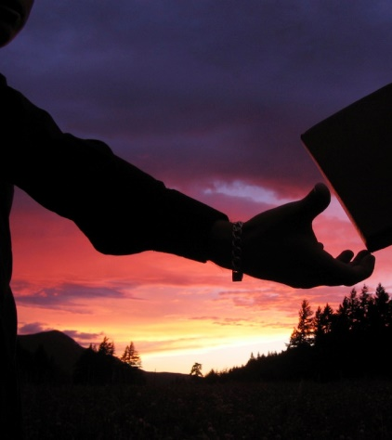
Fellowship With the Apostles
The apostles recorded the truth that they received
(Jn. 16:13; Acts 1:5-8; 2:1-4) for future generations so
that we may have the same fellowship with God and with Jesus Christ that they themselves enjoyed!

Slide 9
Fellowship With the Apostles
Through the gospel of Christ
everyone who obeys can
share in the same faith,
peace, happiness, hope &
joy that the apostles had in
their fellowship with God &
Jesus!

Slide 10
Fellowship With God
I John 1:3
3. “What we have seen and heard we proclaim to you also, so that you too may have fellowship with us; and indeed our fellowship is with the Father…”

Slide 11
Fellowship With God
Through the blood of Christ and
walking in His light (obedience), we
have fellowship with God and with
One another – I Jn. 1:6-7:
“Fellowship” (G2842 koinōnia)
Through obedience we are “called
the children of God” (I Jn. 3:1-2, 22;
Rom. 8:14-17) – fellow workers with God! (I Cor. 3:9)

Slide 12
Fellowship With God
By our fellowship with God we
have fellowship with one
another:
Acts 2:42, 46-47: Early saints are an example of “being of one mind” together!
Rom. 15:26: Churches from all over shared in the contribution to the needy saints in Jerusalem (II Cor. 8:1-5).

Slide 13
Fellowship With God
By obedience to the gospel we have fellowship with God as His children!

Slide 14
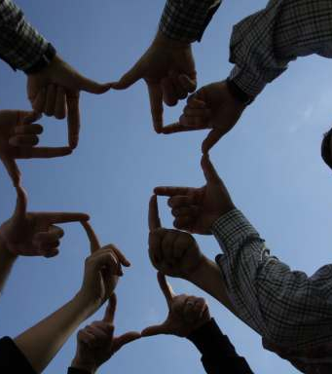
Fellowship With Christ
I John 1:3
3. “What we have seen and heard we proclaim to you also, so that you too may have fellowship with us; and indeed our fellowship is with the Father, and with His Son Jesus Christ.”

Slide 15
Fellowship With Christ
I Cor. 1:9-10; Phil. 1:27;
Rom. 15:5-6; Phil. 3:10:
“fellowship” with Christ
“strive together”
“same mind”
“same judgment”
“standing firm in one spirit”
“with one mind striving together for the faith of the gospel”
“fellowship in His sufferings”

Slide 16
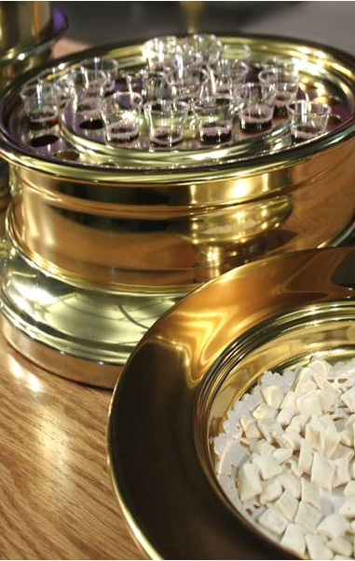
Fellowship With Christ
I Cor. 11:26
26. For as often as you eat this bread and drink the cup, you proclaim the Lord's death until He comes.

Slide 17
Fellowship With Christ
I Cor. 10:16-21 (vss. 16-17)
16. Is not the cup of blessing which we bless a sharing in the blood of Christ? Is not the bread which we break a sharing in the body of Christ? (G2842 koinōnia)
17. Since there is one bread, we who are many are one body; for we all partake of the one bread.

Slide 18
Fellowship With Christ
I Cor. 10:16-21 (vss. 18-19)
18. Look at the nation Israel; are not those who eat the sacrifices sharers in the altar?
19. What do I mean then? That a thing sacrificed to idols is anything, or that an idol is anything?

Slide 19
Fellowship With Christ
I Cor. 10:16-21 (vss. 18-19)
20. No, but I say that the things which the Gentiles sacrifice, they sacrifice to demons and not to God; and I do not want you to become sharers in demons. (G2844 koinonos)
21. You cannot drink the cup of the Lord and the cup of demons; you cannot partake of the table of the Lord and the table of demons.

Slide 20
Fellowship With Christ
By obedience to the gospel we have fellowship with Christ and with one another!

Slide 21
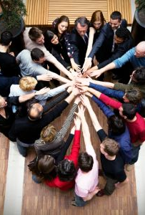
Conclusion
I John 1:4
4. These things we write, so that our joy may be made complete.
Complete joy is the immediate blessing of fellowship – The joy of:
Forgiveness – I Jn. 2:1-2
Hope – I Jn. 3:3
Brotherly love – I Jn. 3:13-14, 17-18, 23
Victory – I Jn. 5:4

Slide 22
Conclusion
III John 4
4. I have no greater joy than this, to hear of my children walking in the truth.

Slide 23
Conclusion
By walking in the Light (I Jn. 1:7) we have fellowship with Jesus and with one another!

Slide 24
Conclusion
Obedience to the gospel grants joy because we gain fellowship with the apostles, God, and Jesus!

Slide 25
“What Must I Do To Be Saved?”
Hear The Gospel (Jn. 5:24; Rom. 10:17)
Believe In Christ (Jn. 3:16-18; Jn. 8:24)
Repent Of Sins (Lk. 13:35; Acts 2:38)
Confess Christ (Mt. 10:32; Rom. 10:10)
Be Baptized (Mk. 16:16; Acts 22:16)
Remain Faithful (Jn. 8:31; Rev. 2:10)
For The Erring Child of God:
Repent (Acts 8:22), Confess (I Jn. 1:9), Pray (Acts 8:22)

