Slide 1
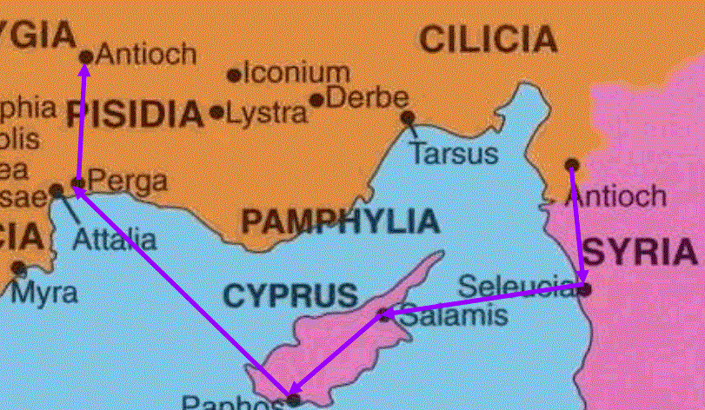
A Tale Of Two Antiochs Text: Acts 11:19; 13:14
Notes:
Prepared by Nathan L Morrison
All Scripture given is from NASB unless otherwise stated
For further study, or if questions, please Call: 804-277-1983 or Visit: www.courthousechurchofcrist.com

Slide 2
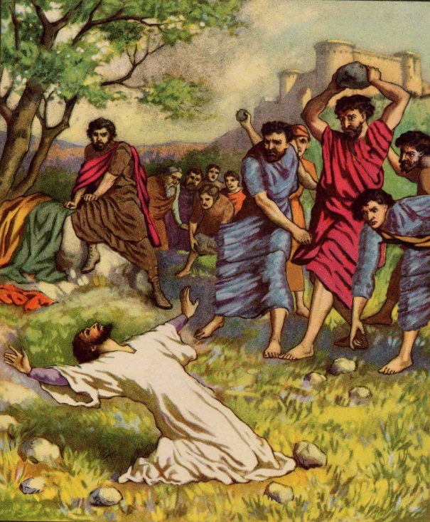
Intro
Acts 1:8 (Jesus said…)
8. but you will receive power when the Holy Spirit has come upon you; and you shall be My witnesses both in Jerusalem, and in all Judea and Samaria, and even to the remotest part of the earth."
Stephen’s death in Acts 7 set a series of events in motion that would cause the church to grow exponentially…
Acts 8:1-5: Saul persecutes the church
“Those who had been scattered went about preaching the word.” (Acts 1:8)
Philip went to Samaria, where Acts 8 focuses on his work there. (Acts 1:8)

Slide 3
Intro
Acts 1:8 (Jesus said…)
8. but you will receive power when the Holy Spirit has come upon you; and you shall be My witnesses both in Jerusalem, and in all Judea and Samaria, and even to the remotest part of the earth."
Stephen’s death in Acts 7 set a series of events in motion that would cause the church to grow exponentially…
Acts 9:26-31: Saul, after his conversion,
joined the disciples at Jerusalem then
leaves for Tarsus
The church throughout all Judea and Galilee and Samaria enjoyed peace! (Acts 1:8)
Peter, after traveling through those regions, went to Lydda and then to Joppa (9:31-42), and then to Caesarea to convert the 1st Gentile, Cornelius (Acts 10)

Slide 4
Intro
Acts 1:8 (Jesus said…)
8. but you will receive power when the Holy Spirit has come upon you; and you shall be My witnesses both in Jerusalem, and in all Judea and Samaria, and even to the remotest part of the earth."
Stephen’s death in Acts 7 set a series of events in motion that would cause the church to grow exponentially…
Acts 11:19-21: Those who scattered after
Stephen’s death went to Phoenicia and
Cyprus and Antioch and taught the Jews
Men of Cyprus and Cyrene taught the Greeks there and “a large number who believed turned to the Lord!”
This Antioch in Syria will become very important in the following years as far as the spread of the gospel is concerned (Acts 13:1-4; 15:35-41; 18:22-23)

Slide 5
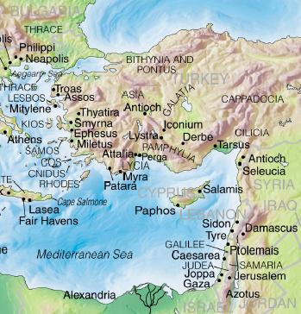
Intro
In the book of Acts we read of two Antiochs:
Antioch of Syria – Acts 11:19
Antioch of Pisidia – Acts 13:14
The outcomes of Paul’s
preaching in these two
cities are very different
and each city is
remembered differently
for their reaction!
A tale of two Antiochs!

Slide 6
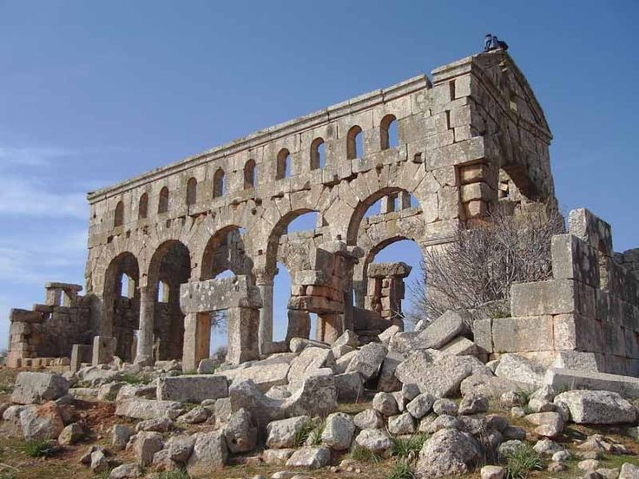
Antioch of Syria
Acts 11:19-21
19. So then those who were scattered because of the persecution that occurred in connection with Stephen made their way to Phoenicia and Cyprus and Antioch, speaking the word to no one except to Jews alone.
20. But there were some of them, men of Cyprus and Cyrene, who came to Antioch and began speaking to the Greeks also, preaching the Lord Jesus.
21. And the hand of the Lord was with them, and a large number who believed turned to the Lord.

Slide 7
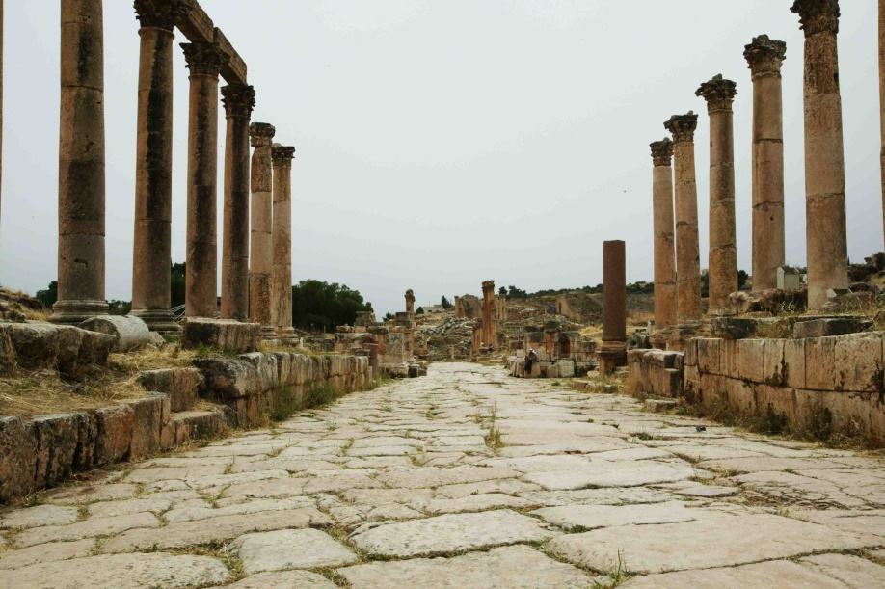
Antioch of Syria
History of Antioch of Syria
On the east bank of the Orontes River, about 300 miles north of Jerusalem.
Founded in 300 BC by Seleucus I Nicator, named after his father Antiochus.
Annexed to Rome by Gen. Pompey in 64 BC, made capital of the Roman province of Syria (Modern Turkey).
A splendid city under the Seleucids, was made still more splendid by Roman emperors.
Called the “Queen of the East,” was the third largest city of the Roman Empire (after Rome and Alexandria), and had a population of approx. 500,000 people!
Julius Caesar visited in 47 BC and declared them free (Roman Citizens!)
Notes:
Sources:
Antioch of Syria:
http://www.bible-history.com/isbe/A/ANTIOCH,+IN+SYRIA/
https://en.wikipedia.org/wiki/Antioch
Nelson’s New Illustrated Bible Dictionary, Antioch of Syria

Slide 8
Antioch of Syria
Acts 11:22-24
22. The news about them reached the ears of the church at Jerusalem, and they sent Barnabas off to Antioch.
23. Then when he arrived and witnessed the grace of God, he rejoiced and began to encourage them all with resolute heart to remain true to the Lord;
24. for he was a good man, and full of the Holy Spirit and of faith. And considerable numbers were brought to the Lord.
Acts 11:22-24
Barnabas = Joseph, a Cyprian, called Barnabas by the apostles, which means, “Son of Encouragement” (Acts 4:36-37)
He was a good man, full of faith and full of the Holy Spirit
One of 3 in the NT called a “good man.” The others are: Jesus (Jn. 7:12) and Joseph of Arimathea (Lk. 23:50) – Two out of three are Josephs!
He lived up to his new name by encouraging others (Acts 11:23)
He was successful in his preaching (Acts 11:24)

Slide 9
Antioch of Syria
Acts 11:25-26
25. And he left for Tarsus to look for Saul;
26. and when he had found him, he brought him to Antioch. And for an entire year they met with the church and taught considerable numbers; and the disciples were first called Christians in Antioch.
Acts 11:25-26
Barnabas went to Tarsus to get Saul (cf. Acts 9:30) & brought him back to Antioch and they worked together there for a year.
Disciples of Christ were first called Christians in Antioch!
Called = chrēmatizō [khray-mat-id'-zo] (G5537): A Divine utterance: - “be called, be admonished (warned) of God, reveal, speak.” (*Used 9 times in NT as reference as a warning or revealing from God)
Not a term of derision by the Antiochians, or a nickname, but a divinely appointed name for followers of Christ (I Pet. 4:16).
Antioch was often called the “Heathen Queen of the East.”
That makes it more amazing that it became such a central hub for Christianity, and the spread of the gospel!
Notes:
*Called (A Divine Utterance)
• Mt. 2:12, 2:22
• Lk. 2:26
• Acts 10:22; 11:26
• Rom. 7:3 (Note on “Adulteress”: God defines morality so this “calling” is from God, cf. Mt. 19:9, 18; Mk. 10:11-12)
• Heb. 8:5; 11:7; 12:25

Slide 10
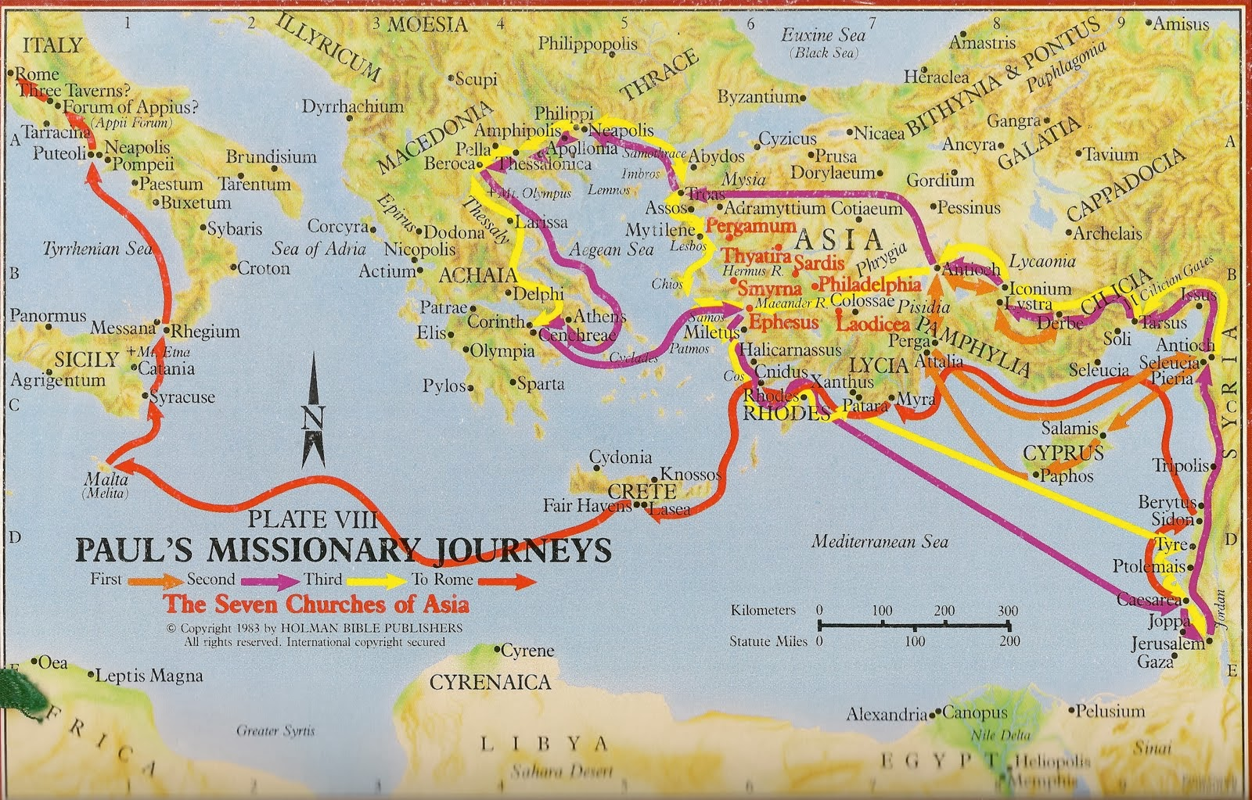
Antioch of Syria
Paul’s Three Missionary Journeys
From Antioch: Acts 13:1-4 (1st); 15:35-41 (2nd); 18:22-23 (3rd)

Slide 11
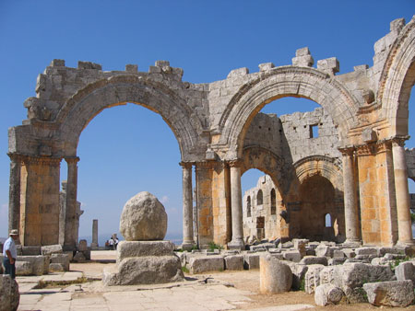
Antioch of Syria
Other Important Info as relates to Christianity
Nicolas, a proselyte of Antioch, was one of the first deacons (Acts 6:5) – Secular writings name him as the father of “the Nicolaitans” (Rev. 2:6, 15)
Antioch saints sent relief to needy saints in Judea when a famine arose (Acts 11:27-30)
It was the church at Antioch, bothered by the words of the Judaizers, that initiated the council at Jerusalem (Acts 14:26-15:35)
It was in Antioch that Paul confronted Peter on his hypocrisy (Gal. 2:11-15)
For a large pagan city
(over 500,000 people),
the people responded well to
the gospel and the church
there flourished!

Slide 12
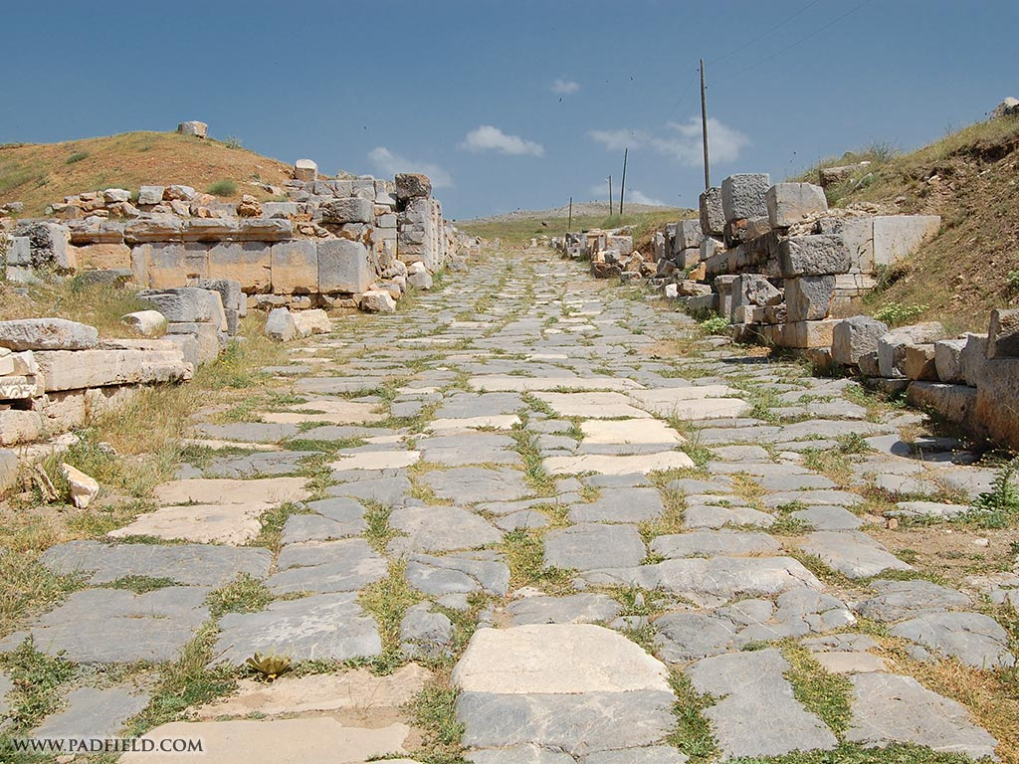
Antioch of Pisidia
Acts 13:13-14
13. Now Paul and his companions put out to sea from Paphos and came to Perga in Pamphylia; but John left them and returned to Jerusalem.
14. But going on from Perga, they arrived at Pisidian Antioch, and on the Sabbath day they went into the synagogue and sat down.

Slide 13
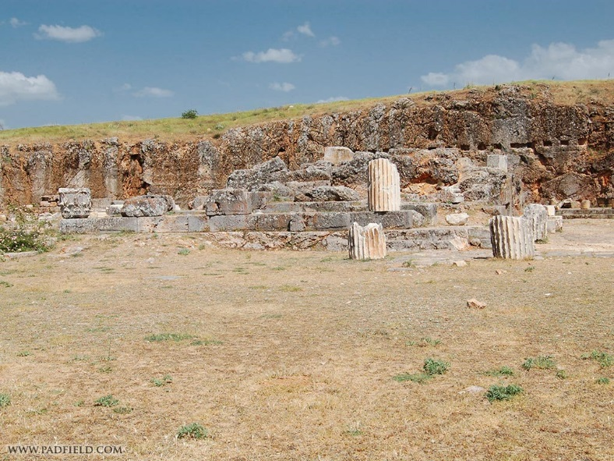
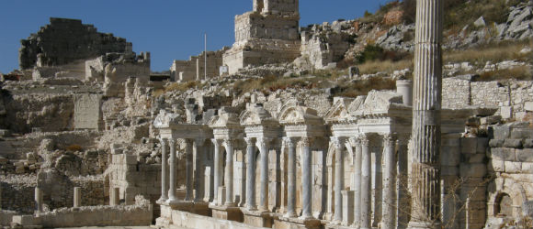
Antioch of Pisidia
History of Antioch of Pisidia
Founded about 300/301 BC by Seleucus I Nicator (Also after his father!)
In 188 BC Rome defeated Antiochus III and declared Antioch a free city
In 25 BC Emperor Augustus made Antioch in Pisidia a Roman colony and gave it the title of Colonia Caesarea Antiochia
The city boasted a population of about 50,000 people!
Emperor Augustus built the Augustus Temple
A fourth century Byzantine church building (dedicated to Paul), stands on the west side of the city and was its largest church building
Massive remains of a Roman aqueduct (North of city) that brought fresh water from springs in the Sultan Mountains about 6 miles from Antioch
Notes:
Sources:
Antioch of Pisidia
http://www.bible-history.com/isbe/A/ANTIOCH,+OF+PISIDIA/
http://www.padfield.com/acrobat/history/pisidian-antioch.pdf
https://en.wikipedia.org/wiki/Antioch_of_Pisidia
Nelson’s New Illustrated Bible Dictionary, Antioch of Pisidia
Images: Left: Ruins of Augustus Temple
Right: Columns

Slide 14
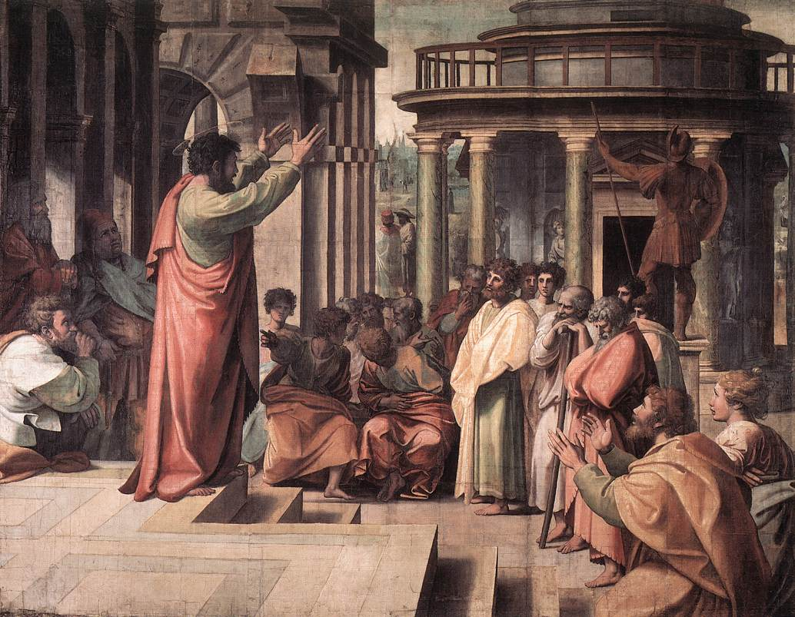
Antioch of Pisidia
Paul’s Sermon and the Outcome – Acts 13:15-41
Paul's sermon was a summary of Jewish history (Acts 13:15-41), the main points being:
God is the God of the people of Israel
God chose the patriarchs for Himself
God redeemed His people from Egypt, leading them through the desert
God gave them the land of Palestine as an inheritance

Slide 15
Antioch of Pisidia
Paul’s Sermon and the Outcome – Acts 13:15-41
Acts 13:35-38: Paul’s sermon mirrors Peter’s on Jesus being raised from the dead (cf. Acts 2:24-27, 38)
Paul ended his sermon with a call to repentance, based on Habakkuk 1:5. He warned the congregation that Habakkuk's words applied to all who reject Jesus as the Messiah.

Slide 16
Antioch of Pisidia
Paul’s Sermon and the Outcome – Acts 13:15-41
Acts 13:42: The Gentiles begged to hear these words the next Sabbath.
Acts 13:45-46: The Jews judged themselves unworthy of eternal life!
Acts 13:48-49: The Gentiles rejoiced and “the word of the Lord spread throughout all the whole region”
Acts 13:50-51: The Jews ran Paul & Barnabas out of the city and they went to Iconium (Followed Paul to Lystra where they stoned him and left him for dead – Acts 14:6-19)

Slide 17
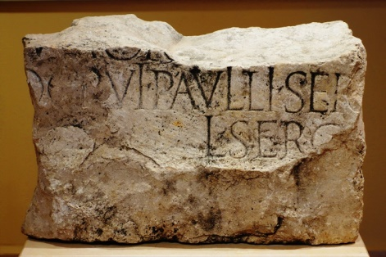
Antioch of Pisidia
Other Important Info as relates to Christianity
Sergius Paulus Inscription: Displayed in the Yalvac museum, clearly shows the whole word of “Paulli” and portions of “Sergii.” The family of Sergii Paulli had large estates in the vicinity of Pisidian Antioch. (On the island of Cyprus, the proconsul, Sergius Paulus [Acts 13:7-12] was converted to Christianity)
II Tim. 3:10-11: Paul mentions an unpleasant incident in the city. (Only Derbe and Lystra mentioned as visited on 2nd Missionary Journey – Acts 16:1)
A smaller pagan city (50,000)
but with a large Jewish
community rejected the
gospel, further opening the
doors to the Gentiles,
who rejoiced!
Notes:
Image: Sergius Paulus Inscription
Dr. Carl Rasmussen, Holy Land Photos (Surmises Sergius Paulus may have sent Paul to Antioch Pisidia, an “off the beaten path” city, and may have even sent him with a letter of introduction)

Slide 18
Conclusion
A Tale of Two Antiochs!
Antioch of Pisidia:
The Jews are remembered for their persecution and rejection of the gospel, while the Gentiles are remembered for being glad to receive the gospel!
Antioch of Syria:
Both Jew and Gentile alike are remembered for their obedience to the gospel and first being called Christians, and being a sound church that spread the gospel!

Slide 19
Conclusion
After hearing the word of God, how will you be remembered?
Unworthy of eternal life?
Or,
Faithful to the word of God and dedicated to sharing the gospel?

Slide 20
“What Must I Do To Be Saved?”
Hear The Gospel (Jn. 5:24; Rom. 10:17)
Believe In Christ (Jn. 3:16-18; Jn. 8:24)
Repent Of Sins (Lk. 13:35; Acts 2:38)
Confess Christ (Mt. 10:32; Rom. 10:10)
Be Baptized (Mk. 16:16; Acts 22:16)
Remain Faithful (Jn. 8:31; Rev. 2:10)
For The Erring Child:
Repent (Acts 8:22), Confess (I Jn. 1:9),
Pray (Acts 8:22)

