Slide 1
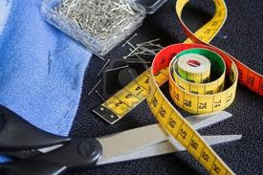
Tailor-Made Religion
Text: I Kings 12:25-33
Notes:
By Nathan L Morrison
All Scripture given is from NASB unless otherwise stated
For Further Study or if Questions, Call: 804-277-1983 or Visit: www.courthousechurchofcrist.com

Slide 2
Intro
We live in a society where if something doesn’t suit you,
you alter it to fit you
There are things people understand to
have set laws (Physics, Sports, etc.)
II Tim. 2:5 (Gal. 1:6-9; II Jn. 1:9; Rev. 22:18-19)
5. Also if anyone competes as an athlete, he does not win the prize unless he competes according to the rules.
Many take the application of “Tailoring” to religion as well
Jeroboam tailored a religion to suit him long ago!
(Eccl. 1:9-10: Nothing new under sun)

Slide 3
Jeroboam's "New" Religion
I Kings 12:25-33 (vss. 25-30)
25. Then Jeroboam built Shechem in the hill country of Ephraim, and lived there. And he went out from there and built Penuel.
26. Jeroboam said in his heart, "Now the kingdom will return to the house of David.
27. "If this people go up to offer sacrifices in the house of the LORD at Jerusalem, then the heart of this people will return to their lord, even to Rehoboam king of Judah; and they will kill me and return to Rehoboam king of Judah."
28. So the king consulted, and made two golden calves, and he said to them, "It is too much for you to go up to Jerusalem; behold your gods, O Israel, that brought you up from the land of Egypt."
29. He set one in Bethel, and the other he put in Dan.
30. Now this thing became a sin, for the people went to worship before the one as far as Dan.

Slide 4
Jeroboam's "New" Religion
I Kings 12:25-33 (vss. 31-33)
31. And he made houses on high places, and made priests from among all the people who were not of the sons of Levi.
32. Jeroboam instituted a feast in the eighth month on the fifteenth day of the month, like the feast which is in Judah, and he went up to the altar; thus he did in Bethel, sacrificing to the calves which he had made. And he stationed in Bethel the priests of the high places which he had made.
33. Then he went up to the altar which he had made in Bethel on the fifteenth day in the eighth month, even in the month which he had devised in his own heart; and he instituted a feast for the sons of Israel and went up to the altar to burn incense.

Slide 5
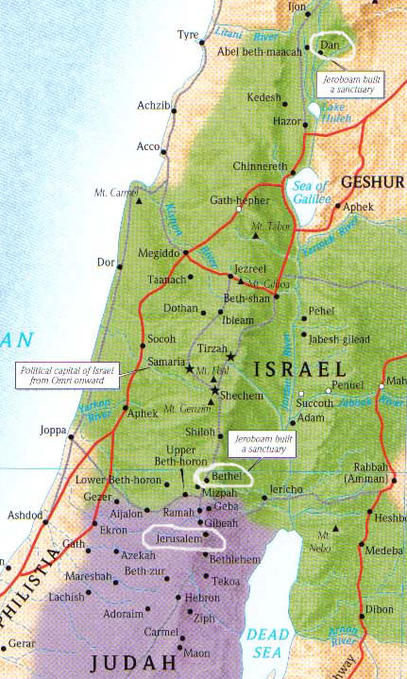
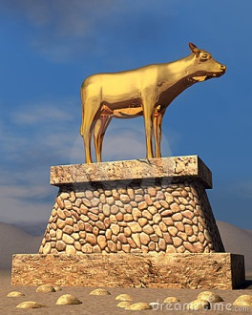
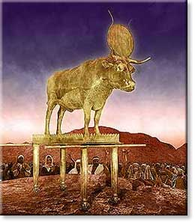
Jeroboam's "New" Religion: “Little” Changes
Object of worship (12:28):
Two Golden Calves
Ex. 20:3-6; 32:4-5
Place of worship (12:29):
Bethel & Dan
Deut. 12:5-7, 11, 13-14, 17-18, 21
I Kings 9:3

Slide 6
Jeroboam's "New" Religion: “Little” Changes
Leaders of worship (12:31):
From among ALL the people who
were not Levis
Num. 25:10-13
Time of worship (12:32-33):
8th month on the 15th day
Ex 12:2-3
Lev 23:24, 27, 34

Slide 7
Jeroboam's "New" Religion
I Kings 12:26-27
26. Jeroboam said in his heart, "Now the kingdom will return to the house of David.
27. "If this people go up to offer sacrifices in the house of the LORD at Jerusalem, then the heart of this people will return to their lord, even to Rehoboam king of Judah; and they will kill me and return to Rehoboam king of Judah."
Jeroboam's "justifications":
Personal preservation (I Kings 12:26-27): Afraid he would lose the people to the House of David.
Convenience (12:28): Too far to travel yearly, so he offered a substitute.
Too exclusive (12:31): The Levitical priesthood was too limited as to who could join.
Similarities (12:32-33): Made a similar feast to those held in Judah, replicated the feasts of Trumpets, Atonement & Booths all in one feast.

Slide 8
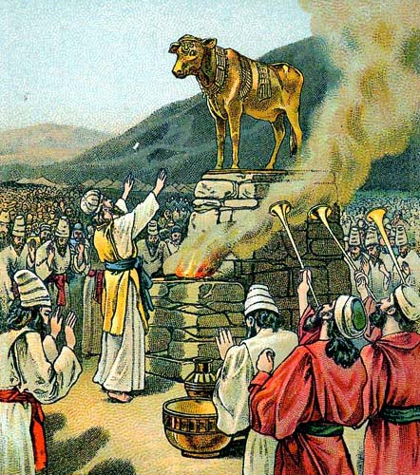
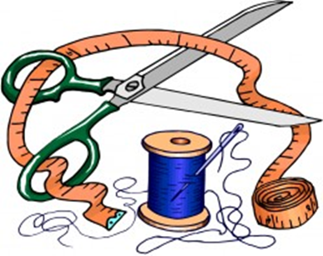
Jeroboam's "New" Religion
Jeroboam’s tailored religion was selfish and caused great harm to Israel!

Slide 9
Consequences of Jeroboam's "Little" Changes
Sinful (I Kings 12:30): Caused the people to sin
Affected others (II Chr. 11:13-17): Levites left
Opened the door for further apostasy (I Kings 16:30-33):
Ahab & Jezebel
Led to the destruction of the House of Jeroboam – I Kings 13:34
(I Kings 15:25-30: Carried out by Baasha)

Slide 10
Consequences of Jeroboam's "Little" Changes
His legacy (II Kings 17:16, 21-23) led to the
destruction of the nation of Israel!
II Kings 17:16, 21-23
16. They forsook all the commandments of the LORD their God and made for themselves molten images, even two calves, and made an Asherah and worshiped all the host of heaven and served Baal.
21. When He had torn Israel from the house of David, they made Jeroboam the son of Nebat king. Then Jeroboam drove Israel away from following the LORD and made them commit a great sin.
22. The sons of Israel walked in all the sins of Jeroboam which he did; they did not depart from them
23. until the LORD removed Israel from His sight, as He spoke through all His servants the prophets. So Israel was carried away into exile from their own land to Assyria until this day.

Slide 11
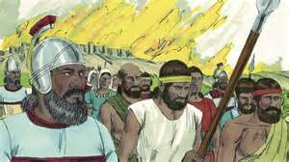
Consequences of Jeroboam's "Little" Changes
Jeroboam’s selfish tailored religion was so
attractive it captivated Israel and led
to their demise!

Slide 12
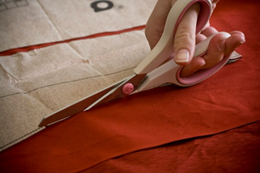
Lessons from Jeroboam’s Tailored Religion
I Cor. 4:6
6. Now these things, brethren, I have figuratively applied to myself and Apollos for your sakes, so that in us you may learn not to exceed what is written, so that no one of you will become arrogant in behalf of one against the other.
N.T. warnings about departing from the faith:
Eph. 4:4-6: There is only One body, One faith, One baptism & One God.
I Cor. 4:6: Not to exceed what is written.
Gal. 1:6-9: Not to preach any other gospel than what the apostles taught.
II Tim. 1:13: Retain the standard of sound word (teaching).
I Pet. 4:11: Speak as the oracles of God, in all things to glorify God.
II John 9: Going too far from the teaching (NKJ: “doctrine”) of Jesus does not have God!
Rev. 22:17-18: Do not tamper with the word of God. It is not for man to change.

Slide 13
Lessons from Jeroboam’s Tailored Religion
Tailoring God’s word to fit us “just so” allows further
apostasy!
II Tim. 2:16-18
16. But avoid worldly and empty chatter, for it will lead to further ungodliness,
17. and their talk will spread like gangrene. Among them are Hymenaeus and Philetus,
18. men who have gone astray from the truth saying that the resurrection has already taken place, and they upset the faith of some.
II Tim. 3:13 (II Tim. 4:3-4)
13. But evil men and impostors will proceed from bad to worse, deceiving and being deceived.

Slide 14
Lessons from Jeroboam’s Tailored Religion
II Tim. 2:5
5. Also if anyone competes as an athlete, he does not win the prize unless he competes according to the rules.
Must play “according to the rules” — not only in sports, but when it comes to religion: Our souls depend on it!

Slide 15
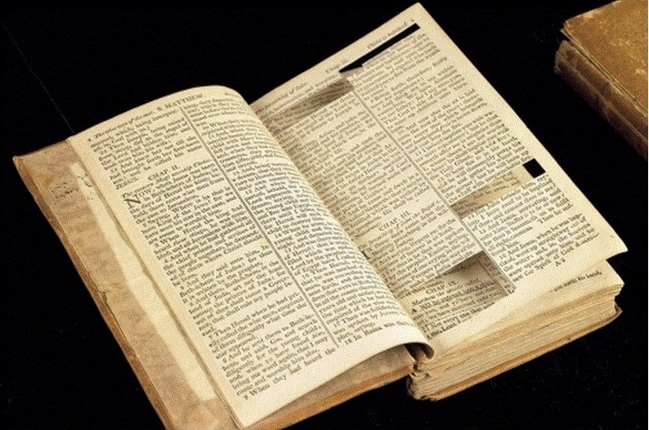
Conclusion
Are you walking in God's ways?
Instead of tailoring God’s word to suit us, we must tailor
our lives to conform to the image of His Son!
(Rom. 8:29; 12:2)
Or, like Jeroboam, are you seeking to tailor God’s word to
fit you just right? (I Cor. 4:6)
Notes:
Image: Jefferson’s Bible

Slide 16
Conclusion
To those who “overcome” by conforming our lives to His
word, there is a crown of life waiting!
(II Tim. 4:8; Rev. 2:10; 21:7)
Notes:
Image: Jefferson’s Bible

Slide 17
“What Must I Do To Be Saved?”
Hear The Gospel (Jn. 5:24; Rom. 10:17)
Believe In Christ (Jn. 3:16-18; Jn. 8:24)
Repent Of Sins (Lk. 13:35; Acts 2:38)
Confess Christ (Mt. 10:32; Rom. 10:10)
Be Baptized (Mk. 16:16; Acts 22:16)
Remain Faithful (Jn. 8:31; Rev. 2:10)
For The Erring Child:
Repent (Acts 8:22), Confess (I Jn. 1:9),
Pray (Acts 8:22)

