Slide 1
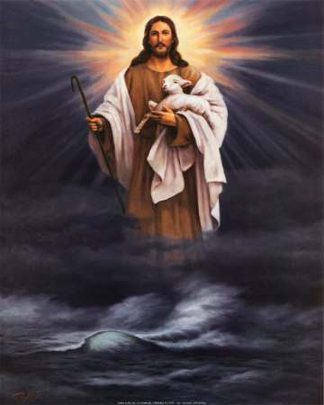
Reflecting The Son
Text: Mt. 5:16; Rom. 8:29-30
Notes:
By Nathan L Morrison
All Scripture given is from NASB unless otherwise stated
For further study or if questions, Call: 907-252-3708, or Visit: www.frr-churchofchrist-ak.org
Presented at Courthouse church of Christ in Chesterfield, VA Saturday PM May 20, 2017

Slide 2
Intro
Jesus is the Light of the world (the source of light)
Jn. 1:4-5
4. In Him was life, and the life was the Light of men.
5. The Light shines in the darkness, and the darkness did not comprehend it.
Jn. 8:12
12. Then Jesus again spoke to them, saying, "I am the Light of the world; he who follows Me will not walk in the darkness, but will have the Light of life."

Slide 3
Intro
Saints are to reflect His Light in letting our lights shine!
Mt. 5:16
16. "Let your light shine before men in such a way that they may see your good works, and glorify your Father who is in heaven.
Rom. 8:29-30
29. For those whom He foreknew, He also predestined to become conformed to the image of His Son, so that He would be the firstborn among many brethren;
30. and these whom He predestined, He also called; and these whom He called, He also justified; and these whom He justified, He also glorified.

Slide 4
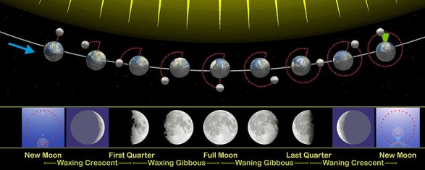
Intro
The sun provides light to the earth (source of light)
The moon provides light at night in varying degrees
(reflects the light of the sun)
The amount of
light the moon
reflects from the
sun is
determined by its
phase:
What phase of the moon are you in as you reflect the
Light of the Son (Christ)?

Slide 5
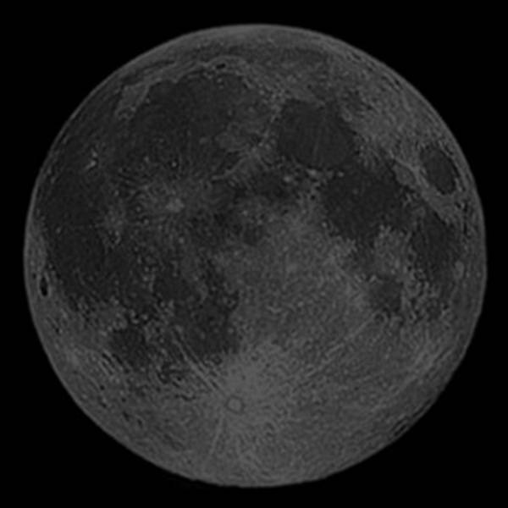
Dark Moon
Reflection of the Son:
No light! Complete darkness!
Jn. 3:19-21 (Mt. 13:19-22: Unbelievers and the fallen)
19. "This is the judgment, that the Light has come into the world, and men loved the darkness rather than the Light, for their deeds were evil.
20. "For everyone who does evil hates the Light, and does not come to the Light for fear that his deeds will be exposed.
21. "But he who practices the truth comes to the Light, so that his deeds may be manifested as having been wrought in God."
Sin is a state of spiritual darkness (I Thess. 5:5)
People of the world (in sin) have a “darkened understanding” (Eph. 4:18)
They do not know the vicious nature of sin:
Moral bondage – Jn. 8:34; II Pet. 2:19
Hardened hearts – Eph. 4:18-19; Heb. 3:12-13
Eternally lost – Rom. 6:23; II Thess. 1:7-9
They don’t know where they are going – Jn. 12:35; I Jn. 2:11; Mt. 25:41,46

Slide 6
Dark Moon
Those in darkness need to repent and be
baptized to wash away sin!
Acts 2:38
38. Peter said to them, "Repent, and each of you be baptized in the name of Jesus Christ for the forgiveness of your sins; and you will receive the gift of the Holy Spirit.
Acts 22:16
16. 'Now why do you delay? Get up and be baptized, and wash away your sins, calling on His name.'
Those who dwell in the darkness of sin, not reflecting the Son, will be eternally punished!

Slide 7
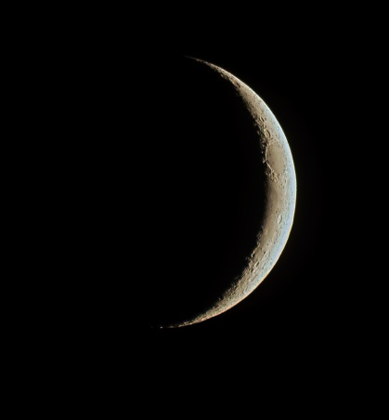
Crescent Moon
Reflection of the Son:
Minimum, sliver of light
Acts 26:16-18 (22-23)
16. 'But get up and stand on your feet; for this purpose I have appeared to you, to appoint you a minister and a witness not only to the things which you have seen, but also to the things in which I will appear to you;
17. rescuing you from the Jewish people and from the Gentiles, to whom I am sending you,
18. to open their eyes so that they may turn from darkness to light and from the dominion of Satan to God, that they may receive forgiveness of sins and an inheritance among those who have been sanctified by faith in Me.'
Waxing:
New convert growing in the knowledge of Christ, or a weak saint becoming stronger – I Pet. 2:1-3; II Pet. 3:18
Waning:
Weak saints due to lack of growth – Heb. 5:12-14
Weak saints falling away for various reasons – Mt. 13:20-22

Slide 8
Crescent Moon
Crescent Moon Saints needs to “grow in respect
to salvation!”
I Pet. 2:2
2. like newborn babies, long for the pure milk of the word, so that by it you may grow in respect to salvation,
Will your light brighten as you reflect the Son,
or will it wink out?

Slide 9
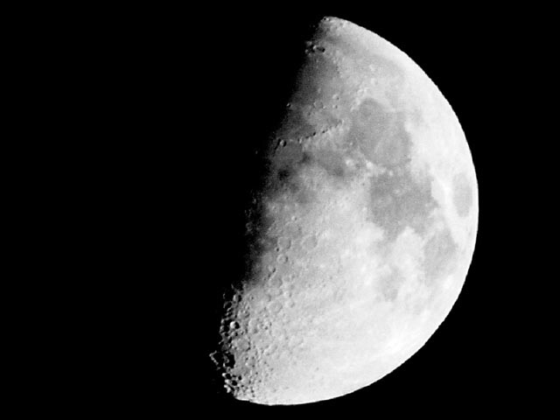
Half Moon
Reflection of the Son:
Bright, half-light, half-darkness
Col. 1:13-14
13. For He rescued us from the domain of darkness, and transferred us to the kingdom of His beloved Son,
14. in whom we have redemption, the forgiveness of sins.
Waxing:
Heb. 6:1-2: Leaving behind the basic (first) principles, this is the saint growing brighter for Christ and more and more reflecting His glory!
(Rev. 2:19)
Waning:
Could describe one who compromises with the world: one foot in the world and one foot in Christ – Rev. 2:12-15 (Pergamum), 18-25 (Thyatira)
I Jn. 1:6: Such a person only fools themselves; lies and does not practice the truth!

Slide 10
Half Moon
Half Moon Saints need to “hold fast” to the good and
“abstain” from even the appearance of evil!
I Thess. 5:21-22
21. But examine everything carefully; hold fast to that which is good;
22. abstain from every form of evil.
Are you growing or weakening in your reflection
of the Son?

Slide 11
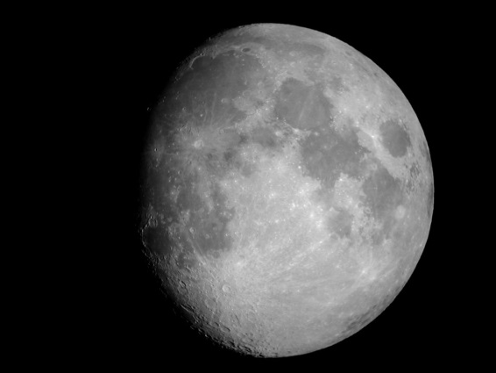
Gibbous Moon
Reflection of the Son:
Brighter, nearly complete reflection
Jn. 12:46
46. "I have come as Light into the world, so that everyone who believes in Me will not remain in darkness.
Waxing:
Jn. 3:21: By practice (Heb. 5:14) the saint leaves the dark for the light!
Rom. 13:12-14: The “armor of light” is put on to contrast the darkness of night, and the saint more and more reflects the Son!
Waning:
A saint burning this brightly starts to lose their light by becoming distracted and unfocused – Mt. 13:22: The Thorny Soil Saint becomes unfruitful!
II Thess. 3:13: Perhaps this is one who becomes weary of doing what is right.

Slide 12
Gibbous Moon
Gibbous Moon Saints need to “not lose heart in doing
good!” (Heb. 12:1-3)
Gal. 6:7-9
7. Do not be deceived, God is not mocked; for whatever a man sows, this he will also reap.
8. For the one who sows to his own flesh will from the flesh reap corruption, but the one who sows to the Spirit will from the Spirit reap eternal life.
9. Let us not lose heart in doing good, for in due time we will reap if we do not grow weary.
Will your light ever brighten as you reflect the Son,
or do you grow weary and lose heart?

Slide 13
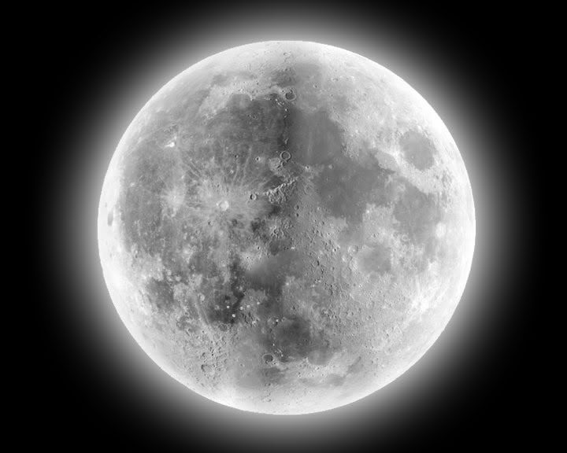
Full Moon
Reflection of the Son:
Radiant, complete reflection
Mt. 5:16 (Lk. 11:33-36)
16. "Let your light shine before men in such a way that they may see your good works, and glorify your Father who is in heaven.
Complete reflection of the Son – Rom. 8:29-30
Eph. 4:14-16: Saints are to “grow up in all aspects into Him!”
I Thess. 5:4-8: God has called us to be “Daylight Disciples!”
Jn. 8:12: Jesus makes “daylight disciples” having the
“Light of life”
His disciples are “children of light.” (Eph. 5:8)
His disciples “walk in the light.” (I Jn. 1:7: contrasted to 1:6)

Slide 14
Full Moon
Eph. 5:7-11
God’s people are not to participate (fellowship) the deeds of darkness but expose them!
Jn. 3:19-21: Evil hates the light for fear the dark
will be exposed!
Full Moon Saints need to continue “abounding in the
work of the Lord!”
I Cor. 15:58
58. Therefore, my beloved brethren, be steadfast, immovable, always abounding in the work of the Lord, knowing that your toil is not in vain in the Lord.
Let your light continue to shine as bright as the Son
so that men will “glorify” God!

Slide 15
Conclusion
People in the world live in the darkness of sin, full of
despair and hopelessness! (Eph. 2:11-12)
God’s people are to be lights, beacons of truth that offer hope to the sick and dying (spiritually) – Mt. 5:16; Phil. 2:15
God’s people are to be “Daylight Disciples” as they walk
in the light of truth (Ps. 119:105)
Do you stray into the dark or stand in contrast to it?
Going just a little into the dark is to walk in darkness and should no longer be a part of a Christian’s life – Eph. 5:3; I Pet. 4:1-3

Slide 16
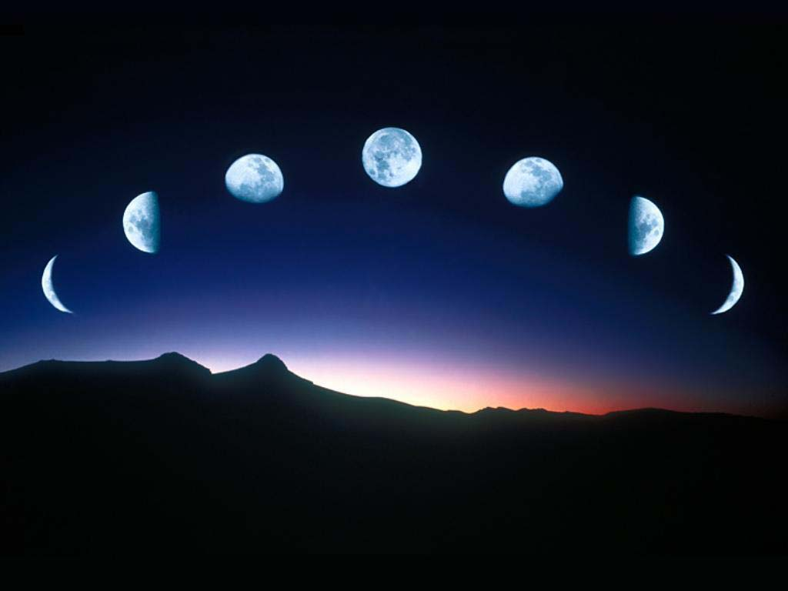
Conclusion
As the moon reflects the light of the sun, saints reflect the
Light of the Son of God (Mt. 5:16; Rom. 8:29-30)
People around us (dark world) only see the light of Christ in us as we reflect the Son!
In reflecting the Son, what phase
of discipleship are you in?
Can others see the light?

Slide 17
“What Must I Do To Be Saved?”
Hear The Gospel (Jn. 5:24; Rom. 10:17)
Believe In Christ (Jn. 3:16-18; Jn. 8:24)
Repent Of Sins (Lk. 13:35; Acts 2:38)
Confess Christ (Mt. 10:32; Rom. 10:10)
Be Baptized (Mk. 16:16; Acts 22:16)
Remain Faithful (Jn. 8:31; Rev. 2:10)
For The Erring Saint:
Repent (Acts 8:22), Confess (I Jn. 1:9),
Pray (Acts 8:22)

